Slide 1
"A green build that never failed in production is not a test strategy."
SUPPLEMENTARY · MODULE 8
Testing Spring Boot
Microservices
Test at the right layer: unit, slice, contract, and Testcontainers so CI proves the same paths OpenShift will run.
🧪
🔺
🎭
✅
SPRING BOOT MICROSERVICES BOOTCAMP • DAY 3 • MODULE 8
Notes:
KEY TALKING POINTS
------------------
- Link to Modules 6 and 7
Modules 6 and 7 added behavior that breaks silently: a circuit breaker that must open after repeated failures and never invent an ACTIVE account, and scope rules that must return 401 and 403 instead of 200.
Module 8 is how those promises are kept.
A security rule or fallback without a test is a rule that disappears in the next refactor, and nobody notices until an incident or an audit.
- What the module covers
It moves from strategy and the pyramid versus trophy debate, through JUnit 5, Mockito and MockMvc, slice tests for the web and JPA layers, full application integration tests, Testcontainers for real PostgreSQL and Kafka, contract and API compatibility testing, end-to-end tests, test data, continuous testing in CI/CD, coverage and brittle tests, and ends with a production-readiness testing checklist.
- How it lands in Lab 3
Lab 3 Step 6 runs mvn test on both services: AccountSecurityTest and TransactionSecurityTest for 401 and 403, AccountCircuitBreakerTest for the open circuit, and the guided AccountPersistenceTest integration test against PostgreSQL.
Exercise 3.3 later in this module has pairs list those tests first.
Contract tests appear in the subtitle but are lecture topics, not part of the lab.
REAL-WORLD EXAMPLES
-------------------
- A team that changes a payment API's authorization rules without automated negative tests may only discover that a read-only role can submit payments during an audit or an incident.
A single 403 test in the pipeline would have caught it on the day of the change.
- Banks moving to frequent releases on container platforms rely on automated test suites as the gate, because a weekly manual regression cycle cannot keep pace with several deployments a day.
USE-CASE SCENARIO
-----------------
Frame the module with a question about the capstone: tomorrow on Day 4 these services go into containers and onto OpenShift through a pipeline.
What stops a teammate from accidentally deleting the transactions.write rule, or changing the fallback to return a fake ACTIVE account?
The answer is tests that fail the build.
By the end of this module every participant should be able to point at the test that guards each Day 3 promise.

Slide 2
THE MICROSERVICES TESTING STRATEGY · TESTING PYRAMID VS. TESTING TROPHY · UNIT TESTING WITH JUNIT 5
📌
WHY A STRATEGY MATTERS
✅
TESTING PRINCIPLES
📌
TESTING PYRAMID
• Microservices increase the number of components, interactions, and failure points
• A layered testing strategy reduces risk and optimizes feedback speed
• Fast feedback at lower levels, confidence at higher levels
• Focus on behavior, not implementation details; test in isolation with clear scope
• Shift left to find defects early; automate for repeatable, reliable results
• Classic model with a wide base of unit tests (70-80% unit, 15-20% integration, 5-10% contract/E2E)
• Best for stable teams, well-defined contracts, and systems needing fast CI/CD feedback
🏆
TESTING TROPHY
📌
KEY JUNIT 5 FEATURES
✅
BEST PRACTICES
• More emphasis on higher-level tests (20-30% unit, 20-30% integration, 20-30% contract, 30-40% E2E)
• Best for new/rapidly changing products where user value matters more than internals
• Modular architecture built on the Jupiter API, extensible
• Simple annotations: @Test, @DisplayName, @BeforeEach, @AfterEach, @Nested
• Powerful assertions, assumptions for conditional tests, dynamic and parameterized tests
• Test one behavior at a time; keep tests small, focused, and fast
• Use meaningful test and method names; avoid test dependencies and side effects
KEY TAKEAWAY Unit, slice, integration, contract, and end-to-end tests each answer a different question at a different cost. • Stable, contract-driven systems suit the pyramid's unit-heavy mix; fast-changing products suit the trophy's integration-heavy mix. • @Test, @DisplayName, assertions, and parameterized tests turn one behavior into one clear, fast, repeatable test case.
1
© 2026 by Innovation In Software Corporation
Notes:
TOPIC 1 OF 3: The Microservices Testing Strategy
------------------------------------------
KEY TALKING POINTS
------------------
- WHY A STRATEGY MATTERS
A monolith has one process to test; our platform already has two services, two databases, a Kafka topic and a REST call between services, and every boundary can fail.
You cannot test everything end to end, because those tests are slow and flaky.
Layering means unit tests check business rules in milliseconds, slice tests check one layer such as web plus security, integration tests check real infrastructure, and a few end-to-end tests check the whole flow.
Fast feedback lower down, confidence higher up.
- TESTING PRINCIPLES
Behavior, not implementation, means asserting that a transaction on a frozen account is rejected, not that a particular private method was called; tests tied to internals break on every refactor.
Isolation with clear scope means a failing test points at one thing.
Shift left means catching the defect on the developer's machine or in the pull request, where it is cheapest to fix.
Automation means the same tests run identically on a laptop and in the Day 4 pipeline, so results are repeatable.
REAL-WORLD EXAMPLES
-------------------
- A payments team that relies mainly on a shared end-to-end test environment often waits hours for results and loses days to environment outages.
Moving business rules into unit tests and service boundaries into integration tests returns most answers in minutes.
- Behavior-focused tests pay off during upgrades: when a team swaps the HTTP client a service uses to call another system, tests that assert outcomes keep passing, while tests that verified internal method calls all have to be rewritten.
USE-CASE SCENARIO
-----------------
Map the layers onto what the Lab 3 solution already ships.
Unit: AccountServiceTest uses the Mockito extension with a mocked repository to prove that create starts an account in PENDING and freeze requires ACTIVE, with no Spring context.
Also unit: AccountCircuitBreakerTest builds a Resilience4j breaker with a four-call window and proves it opens and then throws CallNotPermittedException.
Slice: AccountSecurityTest starts only the web layer with the real SecurityConfig and proves 401 and 403.
Integration: AccountPersistenceTest starts the whole application against PostgreSQL in a Testcontainer and walks an account from PENDING to ACTIVE to CLOSED.
Four questions, four costs.
TOPIC 2 OF 3: Testing Pyramid vs. Testing Trophy
------------------------------------------
KEY TALKING POINTS
------------------
- TESTING PYRAMID
Mike Cohn popularized the pyramid: many fast, cheap unit tests at the base, fewer integration tests, and very few slow end-to-end tests at the top.
The percentages on the slide are rules of thumb some teams use, not a standard, so present them as a starting point.
The pyramid fits services with stable contracts and real business logic, like Account Service's status transitions, where most bugs live in rules that unit tests catch quickly and a fast CI loop pays off.
- TESTING TROPHY
Kent C. Dodds described the trophy for JavaScript applications: static analysis at the base, a modest unit layer, the largest layer of integration tests, and a small end-to-end cap.
The reasoning is that integration tests give the most confidence for their cost.
Correct the panel here: in the trophy, integration is the biggest share, not end-to-end, and contract testing is not one of its layers.
The slide's own takeaway calls it integration-heavy, which is right.
For microservices, the lesson is to invest at service boundaries.
REAL-WORLD EXAMPLES
-------------------
- Spotify engineers described a testing honeycomb for microservices on their engineering blog: mostly integration tests of each service, with few implementation-detail tests and few end-to-end tests, because their services held little complex logic but many integration points.
- An interest and fee calculation engine is logic-heavy, so a pyramid with thorough unit tests fits it well, while a thin API that orchestrates calls to other banking systems gains more from integration and contract tests.
USE-CASE SCENARIO
-----------------
Ask where each capstone service sits.
Account Service has real business rules: PENDING to ACTIVE to FROZEN or CLOSED, USD only, and no updates to closed accounts, so a pyramid fits and AccountServiceTest covers those rules in milliseconds.
Transaction Service is mostly integration: it validates input, calls Account Service with a relayed token, persists, publishes to Kafka, then consumes the event idempotently.
Its riskiest bugs sit at those boundaries, so it leans toward a trophy or honeycomb shape, with TransactionSubmittedConsumerTest, the security slice tests and, in a fuller suite, Testcontainers tests for PostgreSQL and Kafka.
Risk Assessment Service on Day 5 adds a model-call boundary.
TOPIC 3 OF 3: Unit Testing with JUnit 5
---------------------------------------
KEY TALKING POINTS
------------------
- KEY JUNIT 5 FEATURES
JUnit 5 has three parts: the Platform that launches tests, Jupiter with the programming model and annotations, and Vintage for running older JUnit 4 tests.
Extensions are how Mockito and Spring plug in.
The core annotations are Test, DisplayName for readable names, BeforeEach and AfterEach for per-test setup and cleanup, and Nested for grouping related cases.
Assumptions skip a test when a condition is not met, such as no container runtime, and parameterized tests run one method against many inputs.
- BEST PRACTICES
One behavior per test so a failure names the broken rule.
Small and fast so developers run the suite constantly; a test that starts Spring or a database is no longer a unit test.
Meaningful names read like specifications: freezeRequiresActiveStatus states the rule without opening the code.
No dependencies means tests pass alone and in any order; shared mutable state and assumed ordering create failures that only appear in CI.
Build fresh test data in a setup method or helper for each test.
REAL-WORLD EXAMPLES
-------------------
- Fee and interest rules are natural parameterized tests: one test method runs against a table of balances, rates and expected results, so adding a new product tier means adding a row rather than copying another test.
- Teams upgrading older services from JUnit 4 often keep running existing tests through the Vintage engine while writing new tests with Jupiter, which lets them migrate gradually instead of rewriting the whole suite at once.
USE-CASE SCENARIO
-----------------
Open AccountServiceTest from the Lab 3 solution and read it as a JUnit 5 example.
The class registers the Mockito extension and mocks AccountRepository, and a BeforeEach method builds a fresh AccountService for every test.
Each Test method checks one behavior and says so in its name: createStartsAccountInPendingStatus, activateIsIdempotentWhenAlreadyActive, freezeRequiresActiveStatus and closeRetainsTheRecord.
AssertJ assertions check the resulting status, and assertThatThrownBy proves an InvalidAccountStateException when a PENDING account is frozen.
There is no Spring context and no database, so the class runs almost instantly.
Ask the room to propose one parameterized test, such as rejecting several unsupported currencies.

Slide 3
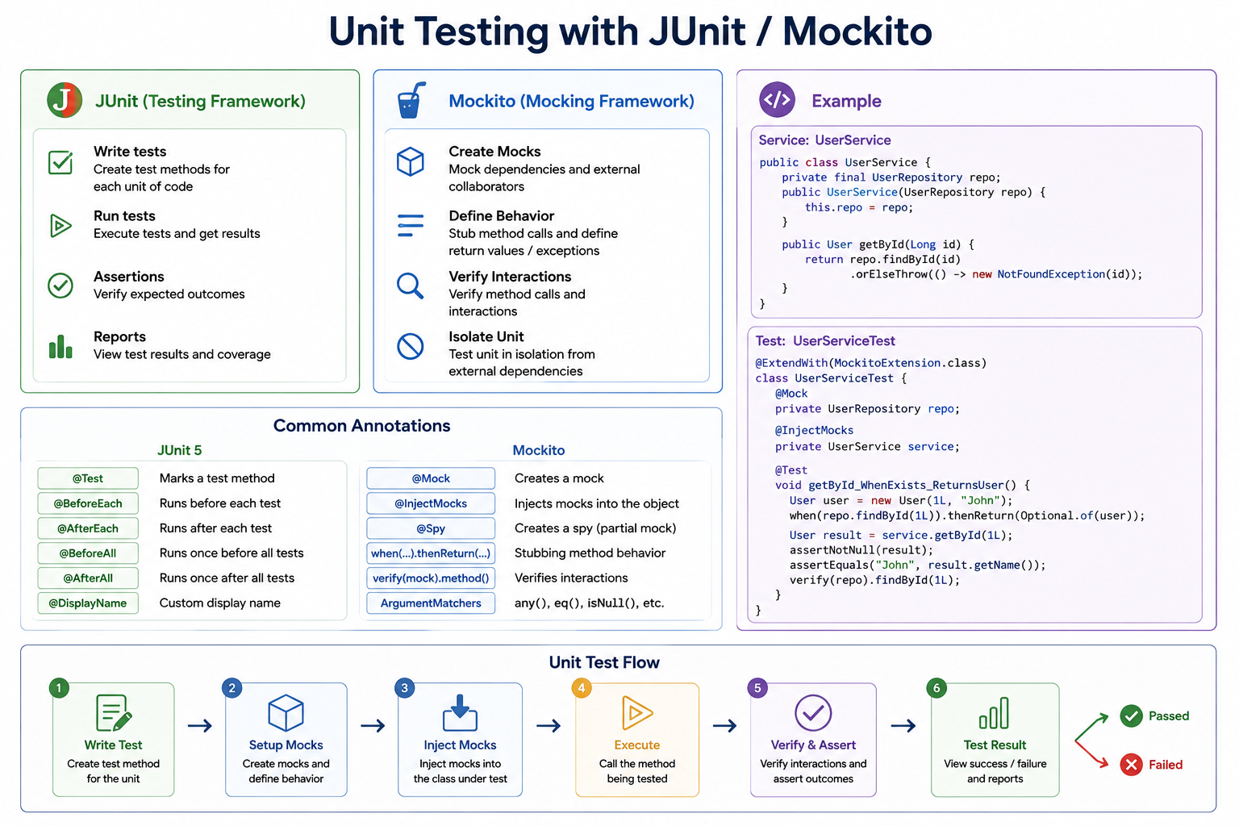
2
© 2026 by Innovation In Software Corporation
Notes:
KEY TALKING POINTS
------------------
- JUnit (Testing Framework)
JUnit 5 (JUnit Jupiter) is the engine.
It finds methods marked with the Test annotation, runs them, and reports pass or fail to Maven Surefire, the IDE and later the CI pipeline.
Assertions are how a test states the expected outcome.
The course solution code uses AssertJ fluent assertions such as assertThat(...).isEqualTo(...), which ship inside spring-boot-starter-test, but plain JUnit assertEquals works the same way.
Reports feed coverage tools; coverage comes back later in Module 8.
- Mockito (Mocking Framework)
Mockito replaces a real collaborator with a programmable fake.
Create Mocks means the repository or HTTP client is never really called.
Define Behavior means you decide what the fake returns or throws for this test.
Verify Interactions means you check that the unit actually called the collaborator, for example that a publisher was never invoked on a rejected transaction.
Isolate Unit is the payoff: no database, no Kafka, no network, so the test runs in milliseconds and fails for exactly one reason.
- Example
The example uses a generic UserService, but the shape is exactly the lab's AccountServiceTest: a service that looks something up in a repository and throws when it is missing.
The test class uses the Mockito JUnit extension, a Mock annotated repository, an InjectMocks annotated service, stubs findById to return an Optional, calls the method and asserts plus verifies.
In the solution the service is built by hand in a BeforeEach method with new AccountService(accountRepository); that is equivalent to InjectMocks and easier to read.
- Common Annotations
Left column is JUnit 5 lifecycle: Test, BeforeEach and AfterEach around every test, BeforeAll and AfterAll once per class, and DisplayName for readable reports.
Right column is Mockito: Mock creates a fake, InjectMocks builds the object under test with the fakes wired in, Spy wraps a real object so only some methods are faked, when-thenReturn stubs, verify checks interactions, and argument matchers such as any() and eq() match parameters loosely.
Remind the room not to mix a matcher and a raw value in the same call.
- Unit Test Flow
The bottom band is the rhythm every unit test follows: write the test method, set up mocks and their behaviour, inject them into the class under test, execute the one method being tested, then verify and assert, and read the result.
It is the Arrange, Act, Assert pattern with the Mockito steps made explicit.
If a test needs more than a handful of stubs to reach the Act step, the class under test is probably doing too much, which is a design signal rather than a testing problem.
REAL-WORLD EXAMPLES
-------------------
- In the Lab 3 solution, TransactionServiceTest mocks AccountClient, TransactionRepository and TransactionSubmittedPublisher.
When the account is FROZEN the test verifies the publisher is never called, proving no event leaves the service for an ineligible account.
- A card authorisation team unit tests its decline rules by mocking the card-status lookup to return blocked, expired or active cards.
Hundreds of rule combinations run in seconds without touching the core banking system or a test card vault.
USE-CASE SCENARIO
-----------------
A developer on the risk platform changes AccountService so that activating an account that is already ACTIVE simply returns it instead of throwing.
Before pushing, they run AccountServiceTest.
The test activateIsIdempotentWhenAlreadyActive stubs the repository to return an ACTIVE account, calls activate, and asserts the status is still ACTIVE, while freezeRequiresActiveStatus confirms a PENDING account still cannot be frozen.
Both run in well under a second with no PostgreSQL running.
The developer knows the lifecycle PENDING to ACTIVE to FROZEN or CLOSED is intact before any integration test or reviewer ever sees the change.

Slide 4
MOCKING DEPENDENCIES WITH MOCKITO · TESTING CONTROLLERS WITH MOCKMVC · TESTING JSON REQUESTS AND RESPONSES
📌
KEY MOCKITO FEATURES
✅
BEST PRACTICES
📌
KEY BENEFITS
• Create mocks easily for interfaces, classes, or concrete dependencies
• Stub behavior: define return values, exceptions, or custom answers
• Verify interactions: confirm methods were called with expected arguments and counts
• Mock only external dependencies, not the class under test
• Verify interactions, but don't test implementation details -- avoid over-mocking
• Fast and isolated -- no need to start the application context or embedded server
• Focus on the web layer: request mappings, validations, status codes, responses
• Rich assertions for JSON payloads, headers, and view names
✅
BEST PRACTICES
📌
WHY IT MATTERS
✅
KEY JSONPATH ASSERTIONS
• Use @WebMvcTest(Controller.class) to load only web layer components
• Mock service/repository dependencies with @MockBean; cover success, validation, not-found, and security scenarios
• Ensures your API contract (request/response) is correct and stable
• Detects serialization, validation, and mapping issues quickly
• $.field for exact value, $.items[*].id for array values, $.items.length() for size
• Always set contentType, validate both happy path and error responses
KEY TAKEAWAY @Mock creates the fake, @InjectMocks wires it in, when(...).thenReturn(...) stubs behavior, and verify(...) confirms the interaction happened. • @WebMvcTest loads only the web layer, @MockBean fakes the service, and mockMvc.perform() drives a real request through the controller. • Asserting only the status code is a common pitfall; the real API contract lives in the JSON payload's fields, types, and nesting.
3
© 2026 by Innovation In Software Corporation
Notes:
TOPIC 1 OF 3: Mocking Dependencies with Mockito
------------------------------------------
KEY TALKING POINTS
------------------
- KEY MOCKITO FEATURES
Mockito can fake interfaces and ordinary classes, which covers repositories, Kafka publishers and REST clients.
Stubbing is more than return values: thenThrow simulates a failure, and thenAnswer computes a result, which the lab uses so that repository.save returns whatever entity it was given.
Verification checks the call happened, how many times, and with what arguments; never() proves a call did not happen, and an ArgumentCaptor lets you inspect the object that was passed, such as the TransactionSubmitted event built by the service.
- BEST PRACTICES
Mock the edges, not the thing you are testing.
If you mock AccountService inside AccountServiceTest you are testing Mockito, not your code.
Verify interactions that are part of the contract, such as no event published for a frozen account, but do not verify every internal call, or a harmless refactor breaks twenty tests.
Over-mocking is the classic smell: when a test stubs value objects, mappers and utilities, prefer real instances and keep mocks for I/O boundaries like the database, the broker and other services.
REAL-WORLD EXAMPLES
-------------------
- A payments team verifies that when a sanctions-screening client throws, the payment service marks the payment as held and never calls the ledger posting client.
Mockito's never() check is the evidence auditors care about: no money moved on an unscreened payment.
- In the Lab 3 solution, TransactionSubmittedConsumerTest stubs processedEventRepository.existsById to return true and then verifies the transaction repository is never read, proving a duplicate Kafka event id is ignored and the consumer stays idempotent.
USE-CASE SCENARIO
-----------------
The Transaction Service team is asked to prove that a FROZEN account can never produce a TransactionSubmitted event.
Rather than spin up Kafka, a developer writes createRejectsFrozenAccount: AccountClient is mocked to throw AccountNotEligibleException for ACC-AABBCCDD, the test asserts the exception propagates, and verify(publisher, never()).publish(any()) confirms nothing was sent.
When a later refactor accidentally moved the publish call above the eligibility check, this one test failed immediately and pointed at the exact rule that had been broken, long before the change reached the shared environment.
TOPIC 2 OF 3: Testing Controllers with MockMvc
------------------------------------------
KEY TALKING POINTS
------------------
- KEY BENEFITS
MockMvc sends requests through the real DispatcherServlet, filters, validation and exception handlers, but no embedded Tomcat starts and no port opens.
One precision for the room: the WebMvcTest slice does start a Spring application context, just a small one holding the web layer, not the whole application.
Tests therefore catch wrong request mappings, missing validation annotations, wrong status codes and malformed JSON in a second or two.
Assertions cover status, headers such as Location and X-Correlation-Id, and JSON body fields.
- BEST PRACTICES
Name the controller in the WebMvcTest annotation so only that controller loads.
The slide says MockBean; in Spring Boot 3.4, which the labs use, MockBean is deprecated and the replacement is the MockitoBean annotation from Spring Framework, which is what AccountControllerTest uses.
Cover four cases per endpoint: success, validation failure, not found, and security.
The lab splits these: controller tests exclude security auto-configuration, while AccountSecurityTest imports SecurityConfig and uses the jwt() request post-processor to test 401 and 403.
REAL-WORLD EXAMPLES
-------------------
- AccountControllerTest in the Lab 3 solution posts a create-account request and expects 201, a Location header ending in /api/v1/accounts/ACC-AABBCCDD, an X-Correlation-Id header, and status PENDING in the JSON body, all without PostgreSQL or a running server.
- A loan origination API team uses MockMvc to prove that an application with a missing income field returns 400 with a VALIDATION_FAILED code and never reaches the underwriting service, which is mocked and verified as untouched.
USE-CASE SCENARIO
-----------------
During Lab 3 a participant locks down Account Service and suddenly every AccountControllerTest fails with 401.
The instructor walks the group through why: the controller tests were written for Lab 1 and never sent a token, and the participant had imported SecurityConfig into them.
The fix follows the solution split.
Business controller tests keep security auto-configuration excluded and stay focused on mappings and error codes.
A separate AccountSecurityTest imports SecurityConfig, sets the lab JWT properties, and proves that no token gives 401 UNAUTHENTICATED and a write-only scope on a GET gives 403 ACCESS_DENIED.
Each test class now fails for one clear reason.
TOPIC 3 OF 3: Testing JSON Requests and Responses
------------------------------------------
KEY TALKING POINTS
------------------
- WHY IT MATTERS
Consumers of an API break on the body, not the status.
If a field is renamed from accountId to id, or an enum starts serialising as a number, the endpoint still returns 201 and every status-only test stays green while the Transaction Service or a front end fails in production.
Asserting fields catches Jackson configuration changes, DTO mapping mistakes, and validation rules that silently stopped firing.
The error body matters too: the lab services return a stable code such as VALIDATION_FAILED or ACCOUNT_NOT_FOUND that clients branch on.
- KEY JSONPATH ASSERTIONS
JsonPath expressions start at the document root: $.accountId for one field, $.items[*].id for every id in an array, and $.items.length() for how many elements came back.
MockMvc exposes them through jsonPath(...).value(...).
Always send contentType application/json on requests with a body, or Spring returns 415 and the test fails for the wrong reason.
Test error paths deliberately: AccountControllerTest asserts $.code equals VALIDATION_FAILED for a non-synthetic customer id, and TransactionControllerTest asserts ACCOUNT_NOT_ELIGIBLE for a frozen account.
REAL-WORLD EXAMPLES
-------------------
- A statement service returns a list of posted transactions.
A JsonPath size assertion plus a check on $.transactions[0].amount caught a change where amounts were serialised as strings, which would have broken the mobile banking app's totals screen.
- In the Lab 3 solution, TransactionControllerTest checks both $.transactionId equals TXN-11111111 and $.status equals RECEIVED on create, so a regression that returned SUBMITTED synchronously or dropped the id would fail immediately.
USE-CASE SCENARIO
-----------------
The Risk Assessment Service being built on Day 5 will consume transaction data, so the Transaction Service response shape is effectively a promise to another team.
A participant adds a new field to TransactionResponse and accidentally renames status to state while refactoring.
The build still compiles and the controller still returns 201.
TransactionControllerTest fails on the JsonPath assertion for $.status with a clear message showing the missing field.
The participant reverts the rename and adds the new field alongside the existing ones, which is an additive, backward-compatible change.
That is exactly the compatibility idea the module returns to later.

Slide 5
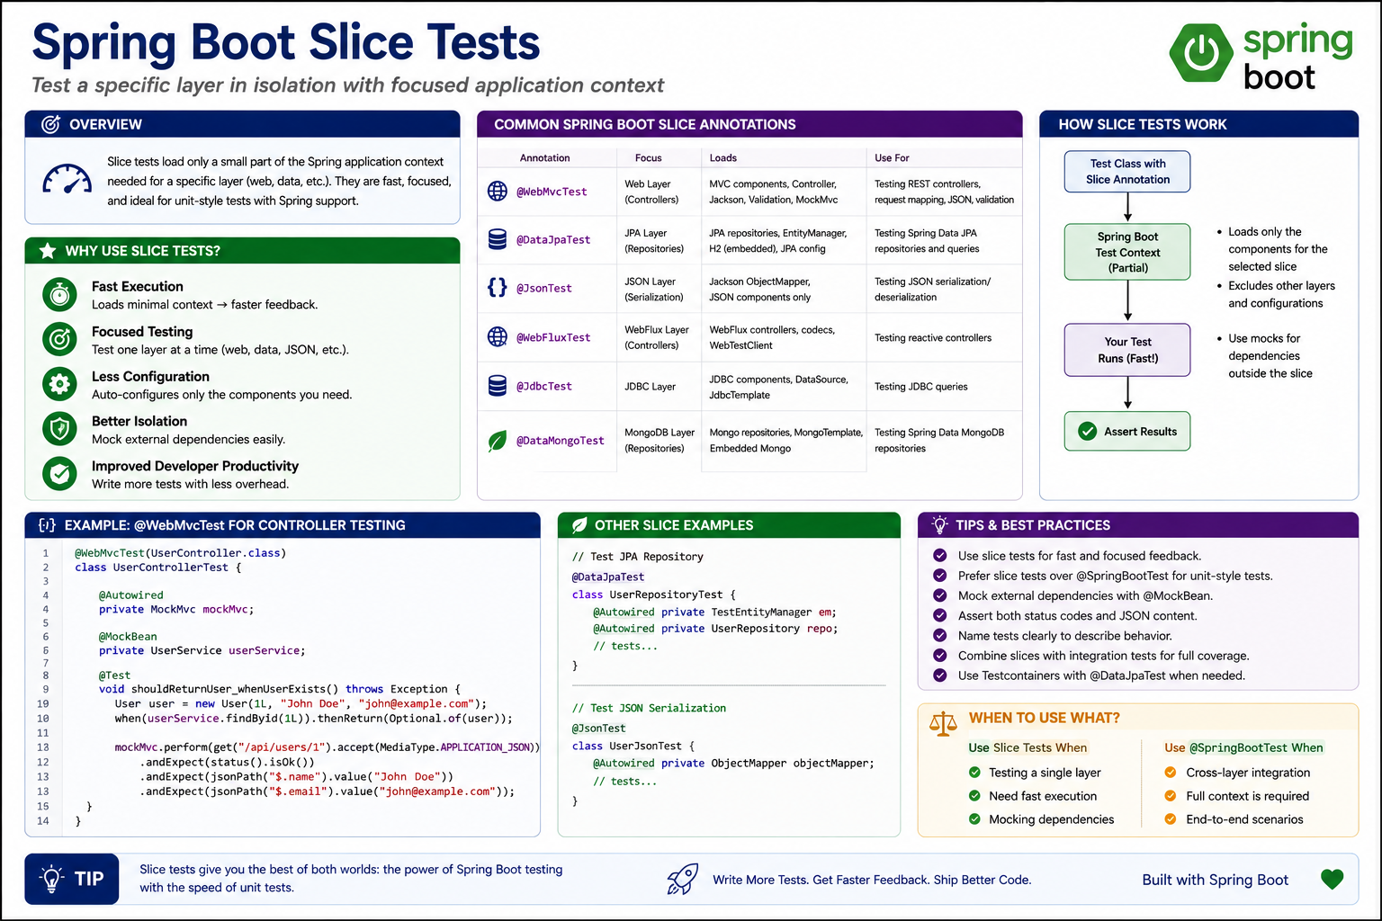
4
© 2026 by Innovation In Software Corporation
Notes:
KEY TALKING POINTS
------------------
- COMMON SLICE ANNOTATIONS
Each slice annotation turns on only the auto-configuration for one layer.
WebMvcTest loads controllers, filters, Jackson and MockMvc, but not services or repositories, so those must be mocked.
DataJpaTest loads entities, repositories, EntityManager and Flyway, and rolls back after each test.
JsonTest loads only Jackson so you can test serialisation of a DTO such as TransactionResponse.
DataMongoTest is the MongoDB equivalent; the course stack is PostgreSQL, so treat it as awareness only.
The poster also shows WebFluxTest and JdbcTest, which follow the same idea.
REAL-WORLD EXAMPLES
-------------------
- The Lab 3 AccountControllerTest and AccountSecurityTest are both WebMvcTest slices: one proves 201, 404 and 409 error codes, the other proves 401 and 403, and neither needs PostgreSQL or Kafka to run.
- A treasury team that publishes FX rate messages uses a JsonTest slice to lock the exact decimal format and ISO currency codes in its JSON, because downstream pricing engines rejected messages when a Jackson upgrade changed number formatting.
USE-CASE SCENARIO
-----------------
A new joiner on the risk platform writes every test with the full SpringBootTest annotation, and the Transaction Service build climbs past several minutes because each test class boots Kafka listeners and a datasource.
In review, the lead maps each test to a layer.
Controller status and error-code checks move to WebMvcTest with a MockitoBean TransactionService.
Event serialisation checks for TransactionSubmitted move to a JsonTest.
Only one test stays full context.
The suite now gives feedback in seconds, and when something breaks the failing slice tells the developer which layer to look at.

Slide 6
REPOSITORY TESTING WITH DATAJPATEST · INTEGRATION TESTING WITH SPRINGBOOTTEST
📌
WHAT @DATAJPATEST PROVIDES
✅
BEST PRACTICES
• Configures an in-memory database (H2 by default), scans @Entity and @Repository
• Configures JPA, Hibernate, DataSource; transactional tests roll back after each test
• Does NOT load the web layer, services, or other slices
• Use TestEntityManager for fine-grained JPA control; clear the persistence context to test real state
• Combine @DataJpaTest with Testcontainers for higher-fidelity database engines
📌
WHY USE @SPRINGBOOTTEST
✅
BEST PRACTICES
• End-to-end validation of the entire application stack; uses real configuration and beans
• Tests multiple layers together: controllers, services, repositories, infrastructure
• Works with embedded databases or Testcontainers for real services
• Use @SpringBootTest sparingly; prefer slice tests for unit scope
• Use @ActiveProfiles("test") for test-specific config; isolate and clean up test data
KEY TAKEAWAY TestEntityManager gives fine-grained control to persist, flush, and clear the persistence context so queries hit the real database, not a cache. • Controllers, services, repositories, and infrastructure all run together -- catching integration issues a slice test can never see.
5
© 2026 by Innovation In Software Corporation
Notes:
TOPIC 1 OF 2: Repository Testing with DataJpaTest
------------------------------------------
KEY TALKING POINTS
------------------
- WHAT @DATAJPATEST PROVIDES
DataJpaTest scans entities and Spring Data repositories, configures Hibernate and a DataSource, runs Flyway if present, and wraps each test in a transaction that rolls back, so tests do not leak rows into each other.
By default it replaces the configured DataSource with an embedded database, but only if one such as H2 is on the test classpath.
The Lab 3 projects have no H2, so a plain DataJpaTest would need a container database.
It never loads controllers, services, security or Kafka.
- BEST PRACTICES
TestEntityManager lets you persist test data, flush it to SQL and clear the persistence context.
Without clearing, a repository query can return the entity straight from Hibernate's first-level cache and never prove the SQL, column mapping or constraint works.
Pair DataJpaTest with Testcontainers PostgreSQL when behaviour depends on the engine: Flyway migrations written for PostgreSQL, unique constraints, JSONB columns or case-sensitive queries.
H2 in compatibility mode is close to PostgreSQL but not identical, and the gaps show up as production-only bugs.
REAL-WORLD EXAMPLES
-------------------
- A retail bank's statement repository used a native PostgreSQL date truncation function.
Tests on H2 passed while production queries failed; moving the DataJpaTest onto a PostgreSQL container caught the next such mismatch before release.
- In Account Service, a repository test that saves an account, flushes, clears the persistence context and reloads it by ACC id proves the Flyway schema and the status enum column mapping agree, not just the in-memory object.
USE-CASE SCENARIO
-----------------
A participant adds a finder to AccountRepository that returns all FROZEN accounts for a customer, for the fraud operations screen.
The first test saves two accounts and immediately queries, and it passes even though the status column mapping is wrong, because Hibernate served the objects from its cache.
The instructor has them add TestEntityManager flush and clear before the query.
The test now fails, revealing that the enum was stored as its ordinal number while the query compared text.
After fixing the mapping to store the enum name, the test passes for the right reason, and the rollback keeps the data out of the next test.
TOPIC 2 OF 2: Integration Testing with SpringBootTest
------------------------------------------
KEY TALKING POINTS
------------------
- WHY USE @SPRINGBOOTTEST
SpringBootTest loads the same auto-configuration the application uses in production: Flyway, JPA, security, Jackson, Actuator.
Slice tests fake the layers they do not load, so they cannot catch a Flyway migration that does not match the entity, a missing bean, or a property that only fails at startup.
With webEnvironment RANDOM_PORT a real server starts on a free port and TestRestTemplate can call it.
Behind it you point at a real database, ideally a Testcontainers PostgreSQL instance as the Lab 3 guided test does.
- BEST PRACTICES
Full-context tests are slow, so keep a few that cover critical paths and push everything else down to unit and slice tests.
The ActiveProfiles annotation with test loads application-test.yml; in Account Service that file sets Hibernate to validate the schema and supplies the lab-only JWT issuer and secret.
Isolate data: generate unique ids per test or clean up afterwards, because SpringBootTest does not roll back HTTP-driven requests.
Spring caches contexts between test classes with identical configuration, so avoid needless per-class differences.
REAL-WORLD EXAMPLES
-------------------
- AccountPersistenceTest in the Lab 3 solution uses SpringBootTest with RANDOM_PORT and the test profile, checks that /actuator/health reports UP, then creates, activates and closes an account and reads it back as CLOSED from a real PostgreSQL 16 container.
- An account-opening platform keeps one SpringBootTest per critical journey, such as open account and first deposit, and runs hundreds of faster slice and unit tests for individual validation rules, which keeps the pull request build fast enough that developers do not skip it.
USE-CASE SCENARIO
-----------------
A participant renames a column in a new Flyway migration for Account Service but forgets to update the entity.
Every unit test and every WebMvcTest still passes, because none of them touch the schema.
The guided integration test AccountPersistenceTest fails at startup: with Hibernate set to validate in application-test.yml, the context refuses to start because the entity and the migrated table disagree.
The participant sees the problem on their laptop in the lab, instead of discovering it when the service is deployed to OpenShift on Day 4 and crashes on start.

Slide 7
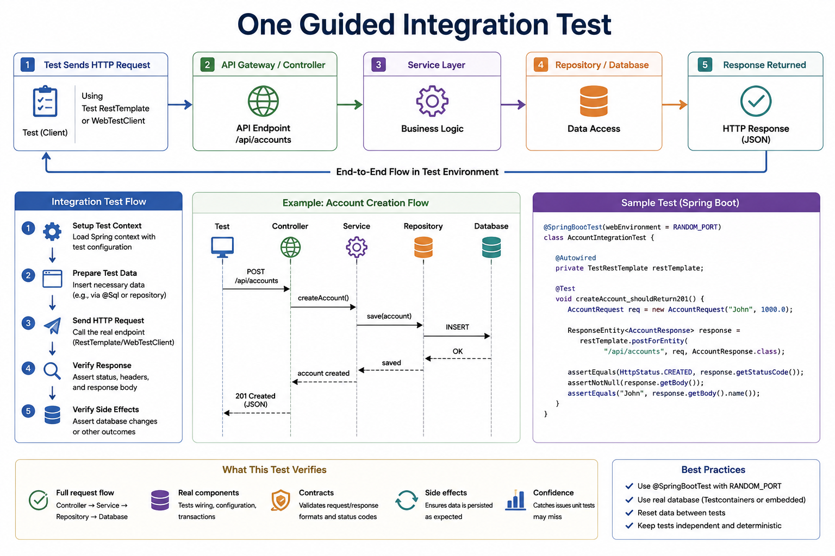
6
© 2026 by Innovation In Software Corporation
Notes:
KEY TALKING POINTS
------------------
- End-to-end request strip
The five boxes across the top are the path a request takes: test client, controller endpoint, business logic, data access, JSON response, with the return arrow labelled end-to-end flow in test environment.
The second box says API Gateway or Controller; there is no gateway in Lab 3, the test calls Account Service directly.
The endpoint shown is /api/accounts; the real lab path is versioned, /api/v1/accounts.
Use the strip to stress that nothing in this path is mocked.
- Integration Test Flow
The left column gives the five steps: set up the test context, prepare test data, send the HTTP request, verify the response, verify side effects.
The last step is what separates integration from controller tests: after the API says 201, read the database or the service back and prove the row is really there with the right status.
In Lab 3's AccountPersistenceTest the context setup includes starting a PostgreSQL container and letting Flyway create the schema before any test runs.
- Example: Account Creation Flow
The sequence diagram shows POST from the test to the controller, createAccount to the service, save to the repository, an INSERT to the database, and the acknowledgements travelling back until the test receives 201 Created with JSON.
In the real Account Service a new account is always created in PENDING status, and the response includes a Location header for the new ACC id.
This is the flow participants built on Day 1, now exercised by a test.
- Sample Test (Spring Boot)
The sample uses SpringBootTest with RANDOM_PORT and an autowired TestRestTemplate, posts a request and asserts 201, a non-null body and the name.
Two corrections for the banking lab: the real create request carries customerId, accountType, currency and an optional nickname, with a synthetic customer id such as CUST-0001, not a person's name and an opening balance; and the real path is /api/v1/accounts.
The actual guided test also checks actuator health and walks create, activate and close.
- What This Test Verifies
The bottom band names five payoffs.
Full request flow means controller, service, repository and database in one pass.
Real components means real wiring, configuration and transactions.
Contracts means real status codes and JSON formats.
Side effects means data is persisted as expected.
Confidence means this test catches the class of bug unit tests miss, such as a Flyway migration that does not match the entity or a transaction boundary in the wrong place.
- Best Practices
Four rules: use SpringBootTest with RANDOM_PORT so parallel builds never fight over port 8081; use a real database through Testcontainers or an embedded one; reset data between tests; keep tests independent and deterministic.
For Lab 3, the real database is a Testcontainers PostgreSQL 16 alpine image, so Docker Desktop must be running for mvn test to pass.
Avoid depending on test execution order or on rows another test created.
REAL-WORLD EXAMPLES
-------------------
- AccountPersistenceTest in the Lab 3 solution starts PostgreSQL 16 alpine with Testcontainers, runs Flyway, confirms /actuator/health returns UP through TestRestTemplate, then creates an account as PENDING, activates it, closes it, and confirms CLOSED is what the database returns.
- A mortgage servicing team keeps one integration test per payment posting path.
It posts a payment through the API and then queries the ledger table to confirm principal and interest rows were written in the same transaction, which unit tests with mocked repositories could never prove.
USE-CASE SCENARIO
-----------------
Before Lab 4 packages Account Service into a container, the team wants proof that the service still works against real PostgreSQL after all the Day 3 security changes.
They run mvn test and AccountPersistenceTest boots the full application on a random port with the test profile, against a throwaway PostgreSQL container.
Health is UP, the account moves PENDING to ACTIVE to CLOSED, and the closed record is still there because the course never hard-deletes accounts.
When the test passes, the team knows the schema, the lifecycle rules and the configuration hang together, not just the individual classes.

Slide 8
TESTING EXTERNAL SERVICE CALLS · TESTCONTAINERS OVERVIEW
📌
TECHNIQUES TO TEST EXTERNAL CALLS
✅
BEST PRACTICES
• Mock with @MockBean: replace the HTTP client bean and stub responses
• MockServer / WireMock: a lightweight HTTP server returning stubbed JSON responses
• Testcontainers + real service: run the real external service in a container for higher fidelity
• Test both happy path and failure scenarios: timeouts, 4xx/5xx errors, malformed responses
• Keep tests deterministic and independent
📌
KEY BENEFITS
✅
COMMONLY USED MODULES
• Real dependencies -- test against the real thing, not mocks
• Isolated and reproducible: clean containers for every test run
• Works locally and in CI, with automatic lifecycle management
• PostgreSQL and Kafka are the classroom stores; Redis/RabbitMQ modules exist in Spring but are lecture-only here
KEY TAKEAWAY Mocking with @MockBean, running MockServer/WireMock, or spinning up the real service in a container each avoid flaky, costly, real external calls. • Throwaway, isolated, and reproducible environments replace mocks with the real infrastructure your service actually depends on.
7
© 2026 by Innovation In Software Corporation
Notes:
TOPIC 1 OF 2: Testing External Service Calls
------------------------------------------
KEY TALKING POINTS
------------------
- TECHNIQUES TO TEST EXTERNAL CALLS
Mocking the client bean is fastest; the slide says MockBean, but in Spring Boot 3.4 use MockitoBean in Spring tests, or a plain Mockito mock in unit tests as TransactionServiceTest does with AccountClient.
A stub server such as WireMock or MockServer runs a real HTTP endpoint, so the RestClient, its timeouts, headers and JSON parsing are exercised too.
Running the real service in a container gives the highest fidelity but costs the most start-up time.
Choose based on what the test must prove.
- BEST PRACTICES
The happy path is the least interesting case for a service that depends on another.
For Transaction Service the key failures are Account Service slow beyond the 3 second read timeout, returning 5xx, returning 409 for a frozen account, or unreachable.
The lab rule is that every failure except the business 409 becomes 503 ACCOUNT_SERVICE_UNAVAILABLE with no event published.
Deterministic means no real network and no sleeps waiting for timing; independent means each test sets up its own stubs.
REAL-WORLD EXAMPLES
-------------------
- In the Lab 3 solution, TransactionServiceTest mocks AccountClient to return an ACTIVE AccountView or throw AccountNotEligibleException, and AccountCircuitBreakerTest builds a Resilience4j circuit breaker around an always-failing call to prove it opens and then throws CallNotPermittedException.
- A bank's bill-pay service calls a third-party payee directory.
The team uses WireMock stubs for a slow response, a 500 and a truncated JSON body, and asserts each one leaves the payment in a pending review state instead of failing silently or paying the wrong payee.
USE-CASE SCENARIO
-----------------
A participant finishes Step 5 of Lab 3 and wants to be sure the fallback is safe, not just that the circuit opens.
They write a test where AccountClient throws AccountServiceUnavailableException and assert that TransactionService propagates it, no transaction is saved as RECEIVED, and the publisher is never called.
A reviewer then asks what happens on a FROZEN account; the participant adds a case confirming the 409 path is rethrown and does not count as a breaker failure.
Together the tests encode the course's fallback rule: never assume an account is ACTIVE when you could not check.
TOPIC 2 OF 2: Testcontainers Overview
-------------------------------------
KEY TALKING POINTS
------------------
- KEY BENEFITS
Testcontainers is a Java library that starts real services in throwaway containers from test code and stops them afterwards.
Real dependencies means real PostgreSQL SQL dialect, constraints and Flyway behaviour, not an emulation.
Isolated and reproducible means each run starts from the same image tag, for example postgres:16-alpine, with no leftover data.
Automatic lifecycle means the JUnit extension starts containers before tests and a cleanup container removes them afterwards.
It needs a container runtime: Docker Desktop in Lab 3, or Podman configured with a compatible socket.
- COMMONLY USED MODULES
Testcontainers ships ready-made modules with sensible defaults.
For this course only two matter: the PostgreSQL module, which Account Service's guided test uses, and the Kafka module, which is already a test dependency in the Transaction Service solution pom but is not used by any Lab 3 test.
Kafka is the event broker from Lab 2 rather than a data store.
One wording fix: the Redis and RabbitMQ modules belong to Testcontainers, not to Spring, and neither technology is in scope for this course.
REAL-WORLD EXAMPLES
-------------------
- The Lab 3 account-service pom declares spring-boot-testcontainers plus the Testcontainers JUnit Jupiter and PostgreSQL modules, and AccountPersistenceTest uses them to run against postgres:16-alpine with database account_db.
- A card payments platform replaced a shared integration database that teams constantly corrupted for each other with per-build PostgreSQL containers.
Failures stopped depending on who else had run tests that morning, and new joiners could run the full suite on day one.
USE-CASE SCENARIO
-----------------
Two participants report that the same Account Service test passes on one laptop and fails on the other.
The failing machine points at a local PostgreSQL left over from an earlier course with an old schema.
The instructor shows how AccountPersistenceTest avoids that entirely: Testcontainers pulls postgres:16-alpine, Flyway builds the schema from the migrations in the project, and the container is thrown away at the end.
Both laptops now test against identical databases.
The only prerequisite is a running container runtime, which is why the lab guide lists Docker Desktop.

Slide 9
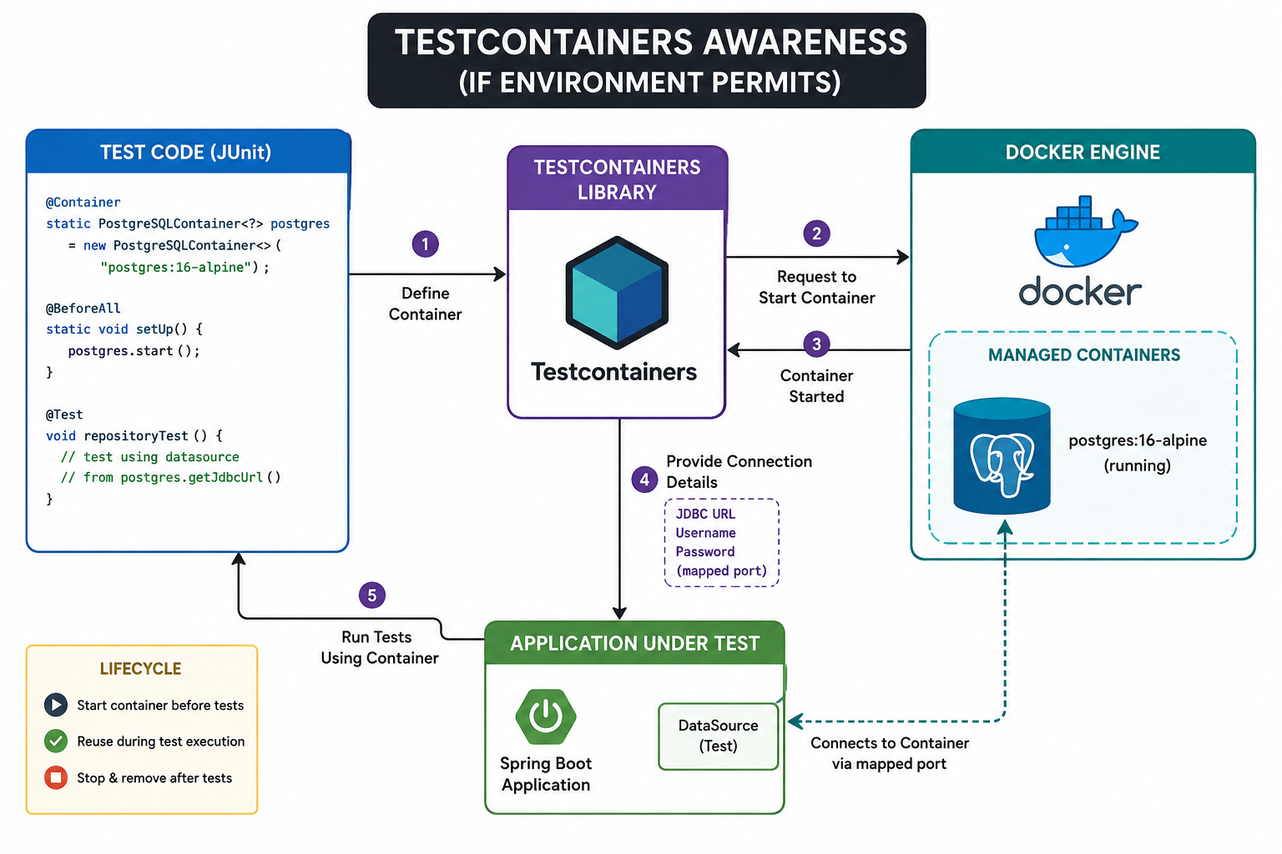
8
© 2026 by Innovation In Software Corporation
Notes:
KEY TALKING POINTS
------------------
- Test Code (JUnit)
The code declares a static PostgreSQLContainer for postgres:16-alpine, the same image tag Lab 3 uses, and a test that reads getJdbcUrl.
Static matters: the container is shared by every test in the class instead of starting once per test.
One caution: the snippet marks the field with the Container annotation and also calls start in a BeforeAll method.
The Container annotation only acts when the class carries the Testcontainers annotation, as AccountPersistenceTest does; then the extension starts and stops it and the manual start is unnecessary.
- Testcontainers Library
The purple box is the library itself.
Arrow one is the test defining what it needs.
Arrow two is the library asking the container runtime to pull the image if necessary and start it on a random free host port.
Arrow three is the runtime reporting the container started; the library waits until PostgreSQL is actually accepting connections, not merely until the process exists.
Arrow four is the library publishing the connection details the application needs.
- Docker Engine
The teal box is the container runtime with the running postgres:16-alpine inside a managed containers area.
On Lab 3 machines that is Docker Desktop.
Testcontainers can also work with Podman when its Docker-compatible socket is exposed, which matters on Red Hat environments.
Some locked-down bank virtual desktops block container runtimes entirely, which is why the course labels this if environment permits and why the environment should be checked before the lab.
- Application Under Test
The green box is the Spring Boot application with a test DataSource that connects to the container through the mapped port shown by the dashed arrow.
The diagram does not show how the connection details reach Spring.
In Lab 3 a DynamicPropertySource method registers spring.datasource.url, username and password from the container, and enables Flyway.
Since Spring Boot 3.1 the ServiceConnection annotation can do the same wiring automatically.
Arrow five is the tests running against that real database.
- Lifecycle
The yellow box summarises the three stages: start the container before tests, reuse it while the test class executes, stop and remove it afterwards.
A static field gives one container per test class; an instance field would give one per test method, which is far slower.
Removal is automatic, including after a crashed run, because Testcontainers runs a small cleanup helper.
Cross-run reuse is a separate opt-in feature for local speed and should not be relied on in CI.
REAL-WORLD EXAMPLES
-------------------
- In the Lab 3 solution, AccountPersistenceTest declares postgres:16-alpine with database account_db and user account, registers the datasource properties through DynamicPropertySource, enables Flyway, and runs the account lifecycle against that container.
- A bank running developer workstations on Red Hat Enterprise Linux uses Testcontainers with Podman's Docker-compatible socket, so the same test code runs on laptops and in OpenShift Pipelines build agents that have container build capability.
USE-CASE SCENARIO
-----------------
On the first morning of Day 3 the instructor runs a two-minute environment check: can each participant's machine start a container?
Most can, and for them AccountPersistenceTest becomes the guided integration test, exactly as drawn: the test declares the container, Testcontainers asks Docker Desktop to start PostgreSQL, Spring receives the mapped port, Flyway builds the schema and the lifecycle test runs.
Two participants are on a locked-down desktop without a container runtime.
They still complete all security and circuit breaker unit tests and follow the integration test on the instructor's screen, which is the intended fallback for an awareness topic.

Slide 10
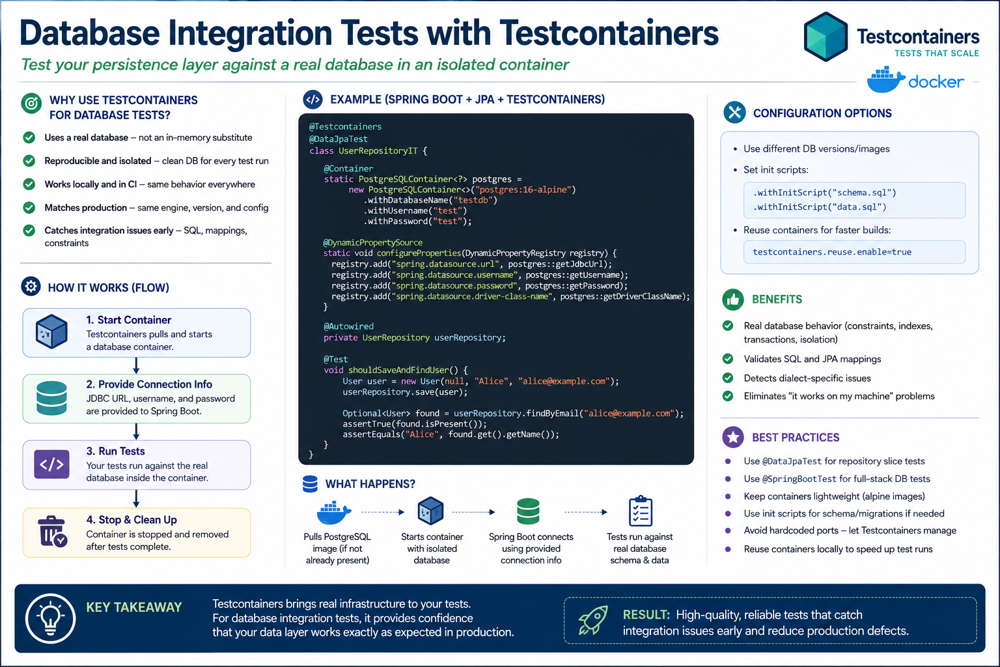
9
© 2026 by Innovation In Software Corporation
Notes:
KEY TALKING POINTS
------------------
- WHY USE TESTCONTAINERS FOR DATABASE TESTS
An in-memory substitute such as H2 accepts SQL and behaviour that PostgreSQL rejects, and the reverse.
A real engine at the same major version as production validates the Flyway migrations exactly as written, enforces the same unique and foreign key constraints, and applies the same types and transaction isolation.
That is where integration bugs hide: a column too short for a real account id, a constraint name that clashes, a native query using PostgreSQL syntax.
Finding them in mvn test is far cheaper than finding them after deployment.
- BEST PRACTICES
Use DataJpaTest when you only need repositories; it is lighter and rolls back each test.
If the slice swaps in an embedded database instead of your container, set the test database replacement to NONE on the AutoConfigureTestDatabase annotation.
Use SpringBootTest when you want Flyway, services and web layer together, as AccountPersistenceTest does.
Alpine images keep pulls small; Lab 3 uses postgres:16-alpine.
Container reuse across runs needs both withReuse on the container and reuse enabled in the developer's Testcontainers properties file, and belongs on laptops, not CI.
REAL-WORLD EXAMPLES
-------------------
- AccountPersistenceTest in Lab 3 applies this pattern with SpringBootTest rather than DataJpaTest, because it also checks Actuator health and runs Flyway migrations and the full account service lifecycle against postgres:16-alpine.
- A lending team's repeat-payment scheduler relied on a PostgreSQL row locking clause so two instances never picked the same instalment.
The behaviour could not be tested on H2, so they tested it against a PostgreSQL container with two concurrent transactions.
USE-CASE SCENARIO
-----------------
The Transaction Service schema gains a unique constraint on event id to back up idempotent Kafka consumption.
A developer writes a repository test against H2 and it passes, but in the shared environment a duplicate insert produces a different error than the code expects.
They move the test onto a PostgreSQL container with the same image tag as the classroom compose file, using DynamicPropertySource for the connection.
The test now reproduces the real constraint violation, the exception handling is fixed, and the duplicate event is logged and skipped cleanly.
No one has to share or clean a common test database.

Slide 11
MESSAGING INTEGRATION TESTS · CONTRACT TESTING FUNDAMENTALS
📌
WHY USE TESTCONTAINERS FOR MESSAGING
✅
BEST PRACTICES
📌
HOW CONTRACT TESTING WORKS
• Inject connection info via @DynamicPropertySource; use unique topics/queues per test
• Use Awaitility for async verifications; keep tests isolated and idempotent
1. Consumer creates a contract defining expected requests and responses
2. The contract (Pact file) is published to a contract repository
3. Provider runs contract tests to verify it meets all consumer expectations
4. If verification passes, the provider can be deployed with confidence
• Tests can run against a real Kafka broker when Testcontainers is available -- otherwise use the classroom Compose broker
• Validates message serialization/deserialization and consumer acknowledgments
• Catches configuration and connectivity issues early
KEY TAKEAWAY Awareness: Testcontainers can run Kafka. Lab 3's guided integration test uses the classroom database unless the VM already supports Testcontainers. • The consumer defines expected requests and responses; the provider verifies it can satisfy that same contract -- both sides trust one shared Pact file.
10
© 2026 by Innovation In Software Corporation
Notes:
TOPIC 1 OF 2: Messaging Integration Tests
-----------------------------------------
KEY TALKING POINTS
------------------
- WHY USE TESTCONTAINERS FOR MESSAGING
Mocks cannot tell you that the JSON serialiser and the consumer's deserialiser disagree about a date field, that trusted packages are misconfigured, or that the consumer group never commits offsets.
A Kafka container, or the classroom compose broker from Lab 2, exercises the real client configuration end to end.
The Transaction Service solution already has spring-kafka-test and the Testcontainers Kafka module as test dependencies, but Lab 3 tests the consumer's logic with Mockito in TransactionSubmittedConsumerTest rather than with a broker.
- BEST PRACTICES
Register the broker's bootstrap servers with DynamicPropertySource just as for PostgreSQL.
Give each test its own topic or consumer group, otherwise a message from one test is consumed by another and failures become random.
Messaging is asynchronous, so never assert immediately after publishing and never use a fixed sleep; Awaitility polls a condition until it is true or a timeout expires, for example until a transaction's status becomes SUBMITTED.
Idempotent tests tolerate redelivery, which mirrors how the consumer itself must behave.
REAL-WORLD EXAMPLES
-------------------
- TransactionSubmittedConsumerTest in the Lab 3 solution checks that a TransactionSubmitted event moves a RECEIVED transaction to SUBMITTED once, that a duplicate event id is ignored, and that a payload with no body is rejected, all with Mockito and no broker.
- A fraud-screening team runs a Kafka container in CI and publishes card authorisation events with an old and a new schema version, asserting with Awaitility that the screening consumer processes both, which caught a deserialisation break before a producer team released.
USE-CASE SCENARIO
-----------------
In Lab 3 Step 4 a participant sees a transaction stuck at RECEIVED.
The unit tests all pass, because TransactionSubmittedConsumerTest calls the consumer method directly.
The instructor uses this to explain the gap a broker-level test would close: the unit test proves the logic, but not that the listener is subscribed to the right topic with the right deserialiser.
The lab troubleshooting table points to the Lab 2 Kafka path.
A Kafka Testcontainers test that publishes an event and uses Awaitility to wait for SUBMITTED would catch the wiring problem automatically; for today it stays awareness.
TOPIC 2 OF 2: Contract Testing Fundamentals
------------------------------------------
KEY TALKING POINTS
------------------
- HOW CONTRACT TESTING WORKS
Integration tests need both services running; contract tests do not.
The consumer's test runs against a Pact mock provider and records the interactions it relies on, only the fields it reads, into a Pact file.
That file is published to a broker.
The provider's build replays each recorded request against the real provider and checks the responses match.
If verification passes, the provider can release without breaking that consumer.
Spring Cloud Contract is a provider-led alternative in the Spring ecosystem.
This is awareness; Lab 3 does not build contracts.
REAL-WORLD EXAMPLES
-------------------
- In the capstone, Transaction Service is a consumer of Account Service's GET account endpoint and reads only accountId, status and currency.
A Pact contract would record exactly those fields, so Account Service could add or change other fields freely.
- A bank's mobile app team publishes contracts for the account summary API it consumes.
The core accounts team verifies them in its pipeline, and a proposed removal of an overdraft field is blocked before release because a published contract still depends on it.
USE-CASE SCENARIO
-----------------
The Account Service team wants to rename the status value FROZEN to BLOCKED to match new operations terminology.
In a shared environment, the first sign of trouble would be Transaction Service returning unexpected errors.
With contract testing, Transaction Service has already published a contract saying it expects status values including FROZEN, and that a FROZEN account makes it reject the transaction with 409.
Account Service's provider verification fails on the pull request that renames the value.
The teams agree to add the new value in a backward-compatible way first, and no transaction for a frozen account is ever wrongly accepted.

Slide 12
CONSUMER-DRIVEN CONTRACT TESTING
A Pact Broker becomes the shared source of truth, letting the consumer and provider teams release independently without breaking each other.
📌
WHY IT MATTERS
✅
BEST PRACTICES
• Reduces integration failures by catching breaking changes before deployment
• Enables independent development -- consumer and provider work in parallel
• Provides living documentation that's always up to date with real usage
• Start with consumers -- write contract tests first
• Use a contract broker for sharing and discovery; verify contracts in CI for every provider change
KEY TAKEAWAY A Pact Broker becomes the shared source of truth, letting the consumer and provider teams release independently without breaking each other.
11
© 2026 by Innovation In Software Corporation
Notes:
KEY TALKING POINTS
------------------
- WHY IT MATTERS
In a microservice estate the most expensive failures happen between teams.
Consumer-driven contracts move the discovery of a breaking change from a shared test environment, or production, to the provider's own pull request build.
Because each team tests against the contract rather than a running copy of the other service, both can release on their own schedules.
And because contracts are generated from real consumer tests, they document which fields and status codes are actually used, which OpenAPI specifications alone cannot tell you.
- BEST PRACTICES
Start with consumers, because they know what they need; a provider-written contract tends to describe everything and protect nothing.
Publish contracts to a broker such as Pact Broker so providers can discover every consumer version they must satisfy.
Run provider verification in the provider's CI on every change, and gate deployment on it; Pact Broker's can-i-deploy check answers whether a given version is compatible with what is already in an environment.
On Day 4 this fits naturally as a step in an OpenShift Pipelines run.
REAL-WORLD EXAMPLES
-------------------
- A digital banking platform has web, mobile and call-centre consumers of one customer profile API.
Each publishes its own contract, and the profile team's pipeline verifies all three, so a change needed only by mobile cannot silently break the call-centre desktop.
- In the capstone, the Risk Assessment Service added on Day 5 will consume transaction data.
A consumer-driven contract would let the Transaction Service team evolve its API without waiting for a full joint test cycle with the risk team.
USE-CASE SCENARIO
-----------------
The risk team building Risk Assessment Service writes a consumer test stating it needs transactionId, accountId, amount, currency and type for a transaction, and publishes that contract to the broker.
The Transaction Service team later proposes changing amount from a number to a string with a currency symbol for display.
Their pull request pipeline pulls the risk team's contract, replays the expected request, and fails because amount is no longer a number.
The change is reworked as a new display field alongside the numeric amount.
Neither team had to schedule a joint environment test, and risk scoring never saw a malformed amount.

Slide 13
API COMPATIBILITY TESTING · END-TO-END TESTING · TEST DATA MANAGEMENT
📌
TYPES OF COMPATIBILITY
✅
BEST PRACTICES
📌
WHAT E2E TESTING VALIDATES
• Backward compatible: new API works with existing consumers without changes
• Forward compatible: existing API can work with newer consumers
• Breaking change: existing consumers may fail with the new API
• Start with consumer-driven contracts; run provider verification in CI on every change
• Use semantic versioning for APIs; automate compatibility checks as a quality gate
• Complete workflows and integrations across service boundaries
• Data integrity, configuration, security, and environment issues
• Confidence before production releases
✅
BEST PRACTICES
📌
TEST DATA LIFE CYCLE
✅
BEST PRACTICES
• Focus on critical business flows, not every path; keep tests independent and idempotent
• Tag tests (e.g., @E2E) and run less frequently than unit tests
• Identify -> Create/Acquire -> Store/Manage -> Provision -> Use & Refresh -> Retire/Archive
• Use Testcontainers to spin up clean, isolated databases
• Mask/anonymize sensitive data (PII) before use; clean up data after tests to avoid contamination
KEY TAKEAWAY Comparing a new API version against its baseline catches whether an added field, removed field, or changed type will break existing consumers. • Order creation flowing through the API gateway, order, inventory, payment, and notification services proves the whole system works together. • Production data must be masked before use; synthetic and reference data avoid that risk entirely while still exercising real scenarios.
12
© 2026 by Innovation In Software Corporation
Notes:
TOPIC 1 OF 3: API Compatibility Testing
---------------------------------------
KEY TALKING POINTS
------------------
- TYPES OF COMPATIBILITY
Backward compatible changes are additive: a new optional request field or a new response field that consumers ignore.
Forward compatibility means an older provider or reader copes with input from something newer, typically by ignoring unknown fields, which is why tolerant JSON readers matter.
Breaking changes include removing or renaming a field, changing a type, making an optional field required, or changing status codes.
The course already practises this: the lab paths are versioned under /api/v1, leaving room for a v2 if a break is ever unavoidable.
- BEST PRACTICES
Consumer-driven contracts tell you who a change would break; running provider verification on every change turns that into an automatic check.
Semantic versioning communicates intent: a major version signals a break, a minor version signals additions.
Automated compatibility checks compare the new OpenAPI description against the last released one and fail the build on a breaking difference.
As a quality gate in the Day 4 pipeline, that stops an accidental break before the image is ever deployed to OpenShift.
REAL-WORLD EXAMPLES
-------------------
- Under open banking programmes, banks publish versioned account and payment APIs to third-party providers they do not control, so removing a field is effectively impossible without a new major version and a published migration period.
- In the capstone, adding a riskScore field to the transaction response on Day 5 is backward compatible for Transaction Service consumers, but changing status from a string to a numeric code would break every client that checks for RECEIVED or SUBMITTED.
USE-CASE SCENARIO
-----------------
The Account Service team wants to split currency into a nested object with code and precision.
An automated comparison against the released OpenAPI description flags it as breaking: a string field changed to an object.
Transaction Service's contract, which reads currency as a string, also fails verification.
The team keeps currency as it is, adds a new currencyDetails object alongside it, and marks the old field deprecated in the documentation.
Transaction Service continues to work unchanged, and can adopt the new field in its own time.
Nothing broke and nothing required a coordinated release weekend.
TOPIC 2 OF 3: End-to-End Testing
--------------------------------
KEY TALKING POINTS
------------------
- WHAT E2E TESTING VALIDATES
An E2E test drives the real, deployed system the way a user or client would.
It proves the services, broker and databases are wired together in a real environment: tokens are accepted across services, the Kafka topic exists, network policies allow the calls, and data flows through intact.
The subtitle's example of an API gateway, order, inventory, payment and notification services is a retail scenario; in this course the equivalent flow is create and activate account, submit transaction, and see it reach SUBMITTED and later be risk-scored.
- BEST PRACTICES
E2E tests are slow, brittle and expensive to debug, so keep only a handful covering the flows that would hurt most if broken.
Make each test create its own synthetic data so tests can run in any order and be rerun safely.
Tag them so they can run separately: JUnit 5 uses the Tag annotation, for example Tag with the value e2e, or a custom meta-annotation such as the E2E one on the slide.
Run them after deployment to a test environment, not on every commit.
REAL-WORLD EXAMPLES
-------------------
- A retail bank runs a small nightly E2E suite in its pre-production environment covering open account, card payment authorisation and statement generation, while thousands of unit and slice tests run on every pull request.
- For the capstone, one E2E test after the Day 4 OpenShift deployment could issue an ops token, submit a transaction for an ACTIVE account, and poll until the status is SUBMITTED, proving security, the account call and Kafka all work together in the cluster.
USE-CASE SCENARIO
-----------------
After the platform is deployed to OpenShift on Day 4, every unit and integration test is green, yet transactions stay at RECEIVED in the cluster.
A single E2E test that submits a transaction with an ops token and waits for SUBMITTED fails and exposes the issue: the Kafka bootstrap address in the deployment configuration still points at the local compose broker.
No lower-level test could have caught it, because it only exists in that environment.
The team fixes the configuration, reruns the E2E test, and adds it to the post-deploy stage of the pipeline so the problem cannot silently return.
TOPIC 3 OF 3: Test Data Management
----------------------------------
KEY TALKING POINTS
------------------
- TEST DATA LIFE CYCLE
Identify what data a test needs, such as an ACTIVE account and a FROZEN one.
Create or acquire it, preferably by generating synthetic records rather than copying production.
Store and manage it in version control as SQL, JSON request files or builder code.
Provision it into the environment the test uses.
Use and refresh it so it does not go stale as the schema changes.
Retire or archive it when tests are removed, so old datasets containing sensitive values do not linger in forgotten environments.
- BEST PRACTICES
Testcontainers gives every run an empty, known database, so data from one test cannot contaminate another.
For banking, the most important rule is data protection: never put real customer data in lower environments; if production-derived data is unavoidable it must be masked or anonymised first under the bank's data policies.
The course goes further and enforces synthetic identifiers in code: AccountControllerTest proves an email-style customer id is rejected with VALIDATION_FAILED, and TransactionControllerTest rejects an account id like real-customer-99.
Clean up after HTTP-driven tests.
REAL-WORLD EXAMPLES
-------------------
- Lab 3 test classes use only synthetic identifiers such as CUST-0001, ACC-AABBCCDD and TXN-11111111, and the log review checklist confirms logs contain ids and correlation ids but never tokens or personal data.
- Banks commonly generate synthetic card numbers that pass format checks but belong to test ranges, so card authorisation and fraud rules can be exercised in lower environments without ever handling a real customer's card.
USE-CASE SCENARIO
-----------------
A developer on the risk platform wants realistic transactions to test fraud-style rules for Day 5, and suggests copying last month's production transactions into the test database.
The instructor walks through the life cycle instead.
The team identifies the patterns they need, such as bursts of small debits and large overnight transfers, and writes a generator that creates synthetic accounts and transactions with CUST, ACC and TXN ids.
The data is stored in the repository, provisioned into a fresh PostgreSQL container per run, refreshed when the schema changes, and deleted with the container.
The tests are realistic, repeatable and carry no customer data at all.

Slide 14
CONTINUOUS TESTING IN CI-CD · CODE COVERAGE AND TEST QUALITY · AVOIDING BRITTLE TESTS
📌
TESTING THROUGHOUT THE PIPELINE
✅
KEY PRINCIPLES
📌
GOOD COVERAGE TARGETS (GUIDELINES)
• Code Commit -> Build -> Unit Test -> Integration Test -> Contract Test -> Packaging -> Deploy -> E2E/Smoke Test
• Each stage has its own quality gate and verification focus
• Shift left: test as early as possible, when defects are cheapest to fix
• Fast feedback, automated end-to-end coverage, and quality gates at every stage
• Unit tests: 80-90% on core business logic and critical paths
• Integration tests: 70-80%; overall project: 70%+; critical modules: 90%+
⚖️
COVERAGE VS. QUALITY
⚠️
WHY TESTS BECOME BRITTLE
✅
STRATEGIES FOR RESILIENT TESTS
• High coverage, low quality: fragile, over-mocked tests give a false sense of security
• Good quality, meaningful coverage: resilient, focused tests that validate real behavior
• Overly coupled to implementation: depending on private methods, internal state, or call order
• Excessive mocking creates false confidence and breaks on refactoring
• Time and environment dependencies make tests unstable
• Test behavior, not implementation; favor real components over mocks
• Control external factors with fixed clocks, Testcontainers, and in-memory DBs
KEY TAKEAWAY Unit, integration, contract, and end-to-end tests each gate a different stage -- from code commit through packaging to deployment. • 80-90% unit, 70-80% integration, and 90%+ on critical modules are sensible coverage targets -- but meaningful coverage matters more than 100%. • Verifying internal method calls, over-mocking, and time-dependent assertions are the three most common ways tests become brittle.
13
© 2026 by Innovation In Software Corporation
Notes:
TOPIC 1 OF 3: Continuous Testing in CI-CD
-----------------------------------------
KEY TALKING POINTS
------------------
- TESTING THROUGHOUT THE PIPELINE
Walk the strip left to right and say what each stage catches.
Unit tests catch logic errors in seconds, such as a FROZEN account being accepted.
Integration tests catch wiring errors, such as a Flyway migration that does not match the entity.
Contract tests catch API drift between Transaction Service and Account Service; they are awareness only on this course.
Packaging produces one image.
A smoke test after deploy proves the running service answers health checks.
Each gate must be able to stop the release, or it is decoration.
- KEY PRINCIPLES
Shift left means finding a defect as close to the keyboard as possible.
Fixing a wrong scope mapping in a unit test takes minutes, while finding it in production means an incident.
Fast feedback keeps the build short enough that developers wait for it instead of skipping it.
Quality gates make the rules non-negotiable.
On Day 4 participants walk a prepared OpenShift Pipelines run whose stages include test, vulnerability scan, SBOM and image signing.
Today's mvn test is the first of those gates.
REAL-WORLD EXAMPLES
-------------------
- Retail banks commonly block a payments service merge when unit or integration tests fail in the pipeline.
A developer who breaks the insufficient-funds rule finds out from a red build within minutes, long before any customer payment is affected.
- Teams that publish consumer-driven contracts, for example with Pact or Spring Cloud Contract, run those checks in CI so a provider cannot rename a JSON field that a card-servicing client still depends on.
USE-CASE SCENARIO
-----------------
A developer on the capstone team changes Account Service so the status field in the account response becomes accountStatus.
Unit tests in Account Service still pass, because they were updated with the change.
Transaction Service, however, reads status to decide whether the account is ACTIVE.
With no contract or integration check in the pipeline, the change reaches the shared test environment and every transaction is rejected.
With a stage that runs Transaction Service's client against the Account API contract, the build fails before merge.
The story shows why each pipeline stage exists: every stage catches a class of defect that the earlier stages cannot.
TOPIC 2 OF 3: Code Coverage and Test Quality
------------------------------------------
KEY TALKING POINTS
------------------
- GOOD COVERAGE TARGETS (GUIDELINES)
Stress the word guidelines.
These are sensible starting points, not a regulatory standard or a Bank of America policy.
Put the highest bar where the risk is highest.
In our platform that means the account eligibility check, the scope rules and the fallback that must never return ACTIVE.
Configuration classes and simple DTOs need far less.
Coverage tools such as JaCoCo measure lines and branches executed; branch coverage matters most for decision logic like status checks.
- COVERAGE VS. QUALITY
A test that calls a method and asserts nothing still raises coverage.
So does a test where every collaborator is mocked to return exactly what the code expects.
Both give false confidence.
A quality test would fail if the behaviour broke.
Lab 3 examples: createWithReadScopeReturns403 asserts both the 403 status and the ACCESS_DENIED code, and the circuit breaker test asserts the OPEN state and a CallNotPermittedException rather than just calling the client.
REAL-WORLD EXAMPLES
-------------------
- A lending team can report very high line coverage on a loan-pricing module and still ship a rounding defect, because none of the tests asserted the calculated rate.
Mutation testing tools such as PIT exist to expose this gap by changing the code and checking whether any test fails.
- Many engineering organisations set a higher coverage expectation for payment authorisation or ledger posting code than for internal admin screens.
That is the risk-based targeting the slide recommends.
USE-CASE SCENARIO
-----------------
During Lab 3 review, two pairs show their Transaction Service tests.
Pair A reports higher coverage, but their AccountClient tests mock RestClient to return ACTIVE every time and assert only that no exception was thrown.
Pair B has less coverage, but their tests prove a missing token gives 401, a read-only scope gives 403, and four failures open the circuit.
Ask the room which pair you would trust to ship the fallback rule.
Pair B's tests would fail if someone added a fallback that returned a synthetic ACTIVE account.
Pair A's would stay green while money moved against a frozen account.
TOPIC 3 OF 3: Avoiding Brittle Tests
------------------------------------
KEY TALKING POINTS
------------------
- WHY TESTS BECOME BRITTLE
Three causes.
A test that verifies a private helper was called in a certain order breaks on every refactor, even when the behaviour is unchanged.
Heavy mocking means the test checks your assumptions about collaborators, not the collaborators themselves.
Time and environment dependencies make results change with the clock or the machine.
Lab example: tokens from issue-jwt.py expire after 12 hours by default, so a test that pasted a real token would fail the next day.
That is why the security tests use the jwt() request post-processor instead.
- STRATEGIES FOR RESILIENT TESTS
Assert what a caller sees: status code, error code, persisted state, published event.
Prefer real components where they are cheap.
AccountCircuitBreakerTest builds a real Resilience4j CircuitBreaker instead of mocking one.
Inject a java.time.Clock so time-based rules can be tested with a fixed instant.
On in-memory databases, be careful: they are fast but can hide PostgreSQL-specific behaviour.
That is why the guided AccountPersistenceTest runs Flyway migrations against PostgreSQL 16 in Testcontainers when Docker is available.
REAL-WORLD EXAMPLES
-------------------
- Statement generation jobs often cut off at month end.
A test that uses the real system clock passes for most of the month and fails around the boundary.
Injecting a fixed clock set to the last day of the month makes the test deterministic.
- Teams that swap an in-memory database for production PostgreSQL in tests sometimes see migrations pass in CI and then fail on deploy because of dialect differences.
Running the same database engine in a container removes that gap.
USE-CASE SCENARIO
-----------------
A participant refactors Transaction Service so account validation moves from TransactionService into a new helper class.
Twelve tests go red, even though every API response is identical.
All twelve verify that transactionService called accountClient.requireActiveAccount exactly once, in a particular order, through a mock.
Meanwhile TransactionSecurityTest and AccountCircuitBreakerTest stay green, because they assert behaviour: 401, 403, and an open circuit that rejects calls.
Use this story to show that the refactor was safe and the tests were brittle, and that rewriting those twelve around observable outcomes is the fix.

Slide 15
PRODUCTION-READINESS TESTING CHECKLIST
Functional, data, integration, resilience, performance, security, observability, configuration, quality, and deployment readiness -- all ten, signed off.
✅
CHECKLIST CATEGORIES (1-5)
✅
CHECKLIST CATEGORIES (6-10)
1. Functional testing: business rules and API contracts behave as specified for valid and invalid input
2. Data & persistence testing: migrations apply cleanly and repositories read and write what you expect
3. Integration testing: the service works against real collaborators, not only against mocks
4. Resilience & reliability testing: timeouts, retries, breakers, and fallbacks behave under failure
5. Performance testing: latency and throughput hold at expected load, with headroom for peaks
6. Security testing: authentication, authorisation, and input validation are enforced, not assumed
7. Observability testing: logs, metrics, and traces actually appear and carry correlation IDs
8. Configuration & environment: one artifact runs everywhere, configured only from outside
9. Quality & test coverage: coverage is meaningful on the paths that carry risk, not just a percentage
10. Deployment readiness: probes, resource limits, rollout strategy, and rollback are all in place
KEY TAKEAWAY Functional, data, integration, resilience, performance, security, observability, configuration, quality, and deployment readiness -- all ten, signed off.
14
© 2026 by Innovation In Software Corporation
Notes:
KEY TALKING POINTS
------------------
- CHECKLIST CATEGORIES (1-5)
Map each item to the capstone.
Functional means Lab 1 validation and status rules such as PENDING to ACTIVE, and 409 for a non-ACTIVE account.
Data and persistence means Flyway migrations and repository behaviour, proven by AccountPersistenceTest.
Integration means Transaction Service really calls Account Service, not only a mock.
Resilience means the 2 s connect and 3 s read timeout, the breaker and the 503 fallback.
Performance was not exercised in our labs; name it as a gap a real team must close with load testing.
- CHECKLIST CATEGORIES (6-10)
Security means 401 and 403 are enforced and tested, not assumed.
Observability means logs carry correlationId, and Day 4 adds metrics and probes.
Configuration means one build configured from outside, which becomes ConfigMaps and Secrets on OpenShift.
Quality and coverage means meaningful tests on risky paths.
Deployment readiness means liveness and readiness probes, resource requests and limits, a rollout strategy and a rehearsed rollback; Lab 4 practises oc rollout undo.
Today closes items 1, 2, 4, 6 and partly 9.
REAL-WORLD EXAMPLES
-------------------
- Many banks run a formal change or release review in which a service owner must show evidence for security testing, monitoring and rollback before a production change is approved.
A checklist like this one is how teams prepare for that conversation.
- Payment platforms often rehearse failure before go-live by stopping a dependency in a test environment and confirming requests fail fast and safely.
That is item 4 in practice, and it is exactly what Lab 3 Step 5 does when participants stop Account Service.
USE-CASE SCENARIO
-----------------
Run a quick readiness review of the capstone as it will stand after Lab 3.
Go down the list and have the room vote green, amber or red.
Security is green: 401 and 403 are tested.
Resilience is green: the breaker opens and callers get 503.
Data is green if AccountPersistenceTest passes.
Observability is amber: correlation IDs yes, metrics and probes not yet.
Performance is red: nobody has load-tested.
Deployment readiness is red: there is no container or OpenShift deployment yet.
The ambers and reds become the Day 4 agenda, which makes the checklist a planning tool rather than a formality.

Slide 16
EXERCISE 3.3 — ADD SECURITY AND RESILIENCE TESTS
Module 8 checkpoint C — Unit + one integration test.
🎯
OBJECTIVE
📝
DO THIS
✅
EXPECTED RESULT
• Unit + one integration test
• 10 min · code warmup checkpoint
• Worksheet: curriculum/day-03/exercises/exercise-3.3-security-resilience-tests.md
1. Unit-test 401/403 on a protected Account or Transaction endpoint
2. Unit-test circuit-open → 503 fallback (no fake ACTIVE account)
3. Name the one integration test you will run (persistence or API with the classroom DB)
4. Testcontainers is awareness only unless the VM already supports it
• A short test list that Lab 3 can tick. Coverage of security and the fallback rule.
• Lab 3 adds unit tests plus one guided integration test (AccountPersistenceTest).
KEY TAKEAWAY A short test list that Lab 3 can tick. Coverage of security and the fallback rule.
15
© 2026 by Innovation In Software Corporation
Notes:
KEY TALKING POINTS
------------------
- OBJECTIVE
Frame this as planning, not coding everything.
In 10 minutes each pair writes the names and assertions of the tests that will prove Lab 3 works, which is several focused unit tests plus exactly one integration test.
The worksheet lives at curriculum/day-03/exercises/exercise-3.3-security-resilience-tests.md.
Keep scope on Account and Transaction services.
The worksheet explicitly rules out extra services and substitute exercises from other course catalogues.
- DO THIS
Security: a web-layer test with MockMvc and the jwt() post-processor, for example POST with no token expecting 401 UNAUTHENTICATED, and POST with only transactions.read expecting 403 ACCESS_DENIED.
Resilience: a test proving four failures open the circuit and the next call throws CallNotPermittedException, plus a check that the resulting response is 503 ACCOUNT_SERVICE_UNAVAILABLE, never ACTIVE.
Integration: name AccountPersistenceTest against PostgreSQL.
Testcontainers needs Docker; the lab VM requires Docker Desktop, so check it is running.
- EXPECTED RESULT
A good list has four to six named tests, each with a clear expected status or state.
For example: createWithoutTokenReturns401, createWithReadScopeReturns403, getWithWriteScopeOnlyReturns403, circuitOpensAfterRepeatedFailuresAndDoesNotInventSuccess, and AccountPersistenceTest proving PENDING to ACTIVE to CLOSED persists.
Note a gap: the solution circuit test stops at CallNotPermittedException, and the HTTP 503 mapping is verified manually in Lab 3 Step 5.
Strong pairs will spot that and add a web-layer 503 test.
REAL-WORLD EXAMPLES
-------------------
- Before changing access rules on a funds-transfer API, a bank team commonly agrees which negative tests must exist: unauthenticated, wrong role, expired token.
A reviewer can then reject the change if those tests are missing, regardless of how good the happy path looks.
- Payment teams that rely on a downstream ledger or account service often keep an automated test that simulates the dependency being unavailable and asserts the payment is rejected rather than approved.
That test is what guards the fail-closed decision over time.
USE-CASE SCENARIO
-----------------
Pair two participants and give them a sticky-note challenge.
A new engineer will join the Transaction Service team next week and could accidentally break security or the fallback rule, so which three tests would catch that on their first pull request?
One pair writes: POST without a token is 401; POST with a teller token is 403 because it lacks transactions.write; with Account Service unavailable, POST is 503 and no transaction row exists.
Then they add AccountPersistenceTest as the integration test.
In the debrief, ask which of those tests would fail if someone returned new AccountView with status ACTIVE from the fallback.
The answer should be the 503 test, and if no test would fail, the list is not finished.

Slide 17
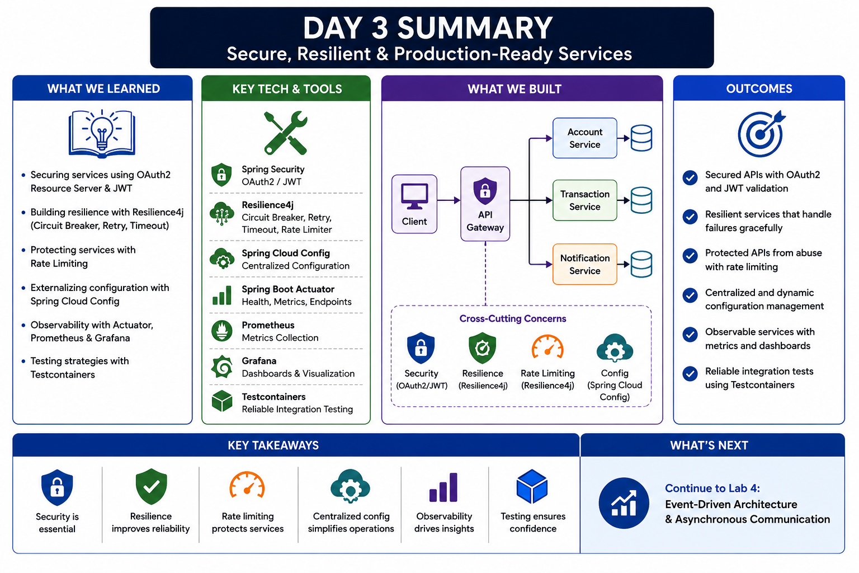
16
© 2026 by Innovation In Software Corporation
Notes:
KEY TALKING POINTS
------------------
- Top banner
The title promises secure, resilient, production-ready services.
Be honest about scope.
After Lab 3 the Account and Transaction services are secured and fail safely, but they are not production-ready until Day 4 adds probes, containers, OpenShift deployment and a pipeline.
Production-ready is a checklist you finish across two days, not a label you earn from one lab.
- What We Learned
Three bullets match today's modules: OAuth2 resource server with JWT (Module 7), Resilience4j circuit breaker and timeout (Module 6), and testing (Module 8).
The others need care.
Rate limiting was a conceptual overview only.
Spring Cloud Config is not in the course stack; externalised configuration on this course means application.yml today and OpenShift ConfigMaps and Secrets on Day 4.
Actuator health is used today, but Prometheus and Grafana observability is Day 4 material.
- Key Tech and Tools
Spring Security, Resilience4j, Actuator and Testcontainers are the tools participants actually touch.
In Lab 3, Actuator exposes only health and info, and Testcontainers runs the guided AccountPersistenceTest against PostgreSQL 16.
Resilience4j is used for the circuit breaker; retry is awareness only, and the timeout is the RestClient 2 s connect and 3 s read setting.
Spring Cloud Config, Prometheus and Grafana are common in enterprises, but no lab installs them.
- What We Built
The picture shows a client, an API gateway and Account, Transaction and Notification services.
That is not our capstone.
The AI-Assisted Banking Transaction Risk Platform has Account Service on 8081 and Transaction Service on 8082, each with its own PostgreSQL database, plus Kafka events from Lab 2.
Transaction Service calls Account Service directly with the caller's relayed JWT.
The third service is Risk Assessment Service on Day 5.
There is no gateway and no notification service.
- Outcomes
Anchor each outcome in something testable.
Secured APIs means no token gives 401 and the wrong scope gives 403 with ACCESS_DENIED.
Graceful failure means POST returns 503 ACCOUNT_SERVICE_UNAVAILABLE and never invents an ACTIVE account.
Rate-limit protection and dynamic configuration are not Lab 3 outcomes.
Observable services with dashboards is Day 4.
Reliable integration tests means AccountPersistenceTest passing under mvn test.
- Key Takeaways
Six short statements: security is essential, resilience improves reliability, rate limiting protects services, centralised config simplifies operations, observability drives insight, and testing builds confidence.
Turn them into questions.
Where is the evidence for each one in our code?
For security and resilience it is the test classes.
For observability it is correlationId in logs today and metrics on Day 4.
A takeaway with no evidence is only a slogan.
- What's Next
The box says Continue to Lab 4: Event-Driven Architecture and Asynchronous Communication.
That is wrong on two counts.
Lab 3, Secure and Resilient Services, is still to come today.
Event-driven messaging with Kafka was Day 2 and Lab 2.
The correct preview is Day 4 and Lab 4, Deploy the Capstone Services: non-root container images, probes, ConfigMaps and Secrets, deployment to OpenShift, a pipeline with scan, SBOM and signing, and a rollback.
REAL-WORLD EXAMPLES
-------------------
- A bank's card authorisation API is usually protected by an identity provider issuing short-lived tokens, while each API validates the token itself.
That split is the same one we use today: Keycloak or a client IdP issues tokens, and Account and Transaction services act as resource servers.
- Netflix popularised the circuit breaker in Java microservices through its open-source Hystrix library, which is now in maintenance mode.
Resilience4j is a commonly recommended successor, which is why the course uses it.
USE-CASE SCENARIO
-----------------
Picture a platform review board looking at the Transaction Service before a pilot.
The first question is who can move money: only callers whose token carries transactions.write.
The second is what happens when Account Service is down: callers get a 503 within seconds, no transaction row is saved, no event is published, and no account is assumed ACTIVE.
The third is how the team knows it works: named tests for 401, 403 and the open circuit, plus a persistence test against real PostgreSQL.
Someone asks about dashboards and deployment, and the honest answer is that those come on Day 4.
That is exactly the Day 3 summary this platform can defend.

Slide 18
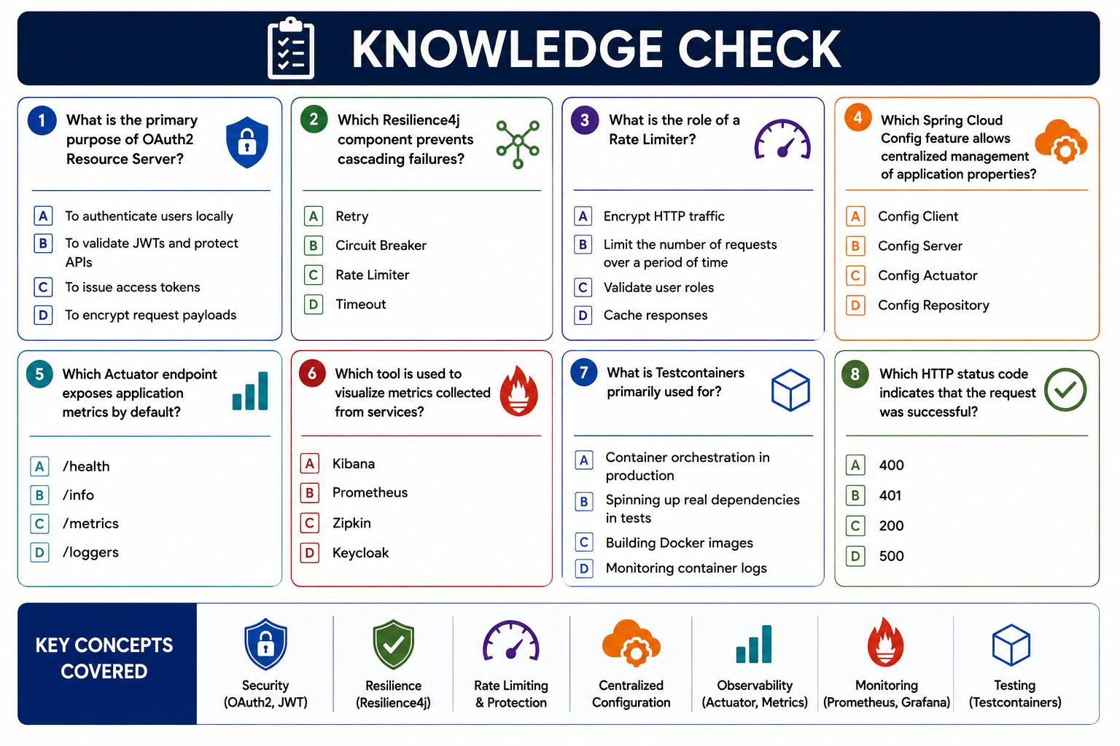
17
© 2026 by Innovation In Software Corporation
Notes:
KEY TALKING POINTS
------------------
- Question 1: primary purpose of an OAuth2 Resource Server
Answer B, to validate JWTs and protect APIs.
A resource server checks the token's signature, issuer, expiry and scopes on every request.
It does not log users in (A) and does not issue tokens (C); issuing is the authorization server's job, played by Keycloak or a client IdP in production and by tools/issue-jwt.py in the lab.
Encrypting payloads (D) is TLS or a separate concern.
- Question 2: Resilience4j component that prevents cascading failures
Answer B, Circuit Breaker.
Once enough calls to a failing dependency fail, it stops calling and fails fast, so threads are not tied up waiting.
Retry (A) can make a cascade worse by adding load to a struggling service.
A rate limiter (C) protects a service from excess traffic.
A timeout (D) bounds a single wait.
In Lab 3 the breaker wraps AccountClient.requireActiveAccount.
- Question 3: role of a Rate Limiter
Answer B, it limits the number of requests over a period of time.
It does not encrypt traffic, validate roles or cache responses.
Remind the room that rate limiting was a conceptual topic in Module 6 and is not built in Lab 3.
In banking it is often applied at an API gateway or platform layer to protect login and payment endpoints from abuse.
- Question 4: Spring Cloud Config feature for centralised properties
Answer B, Config Server.
The server serves properties from a backing repository to Config Client applications.
Be clear that Spring Cloud Config is not part of the MD287 stack.
Today configuration lives in application.yml, with the classroom JWT secret there for the lab only.
On Day 4, OpenShift ConfigMaps hold settings such as URLs and Secrets hold passwords and the JWT secret.
Treat this question as general awareness.
- Question 5: Actuator endpoint that exposes metrics
Intended answer C, /metrics.
The endpoint exists, but the words by default are misleading.
Spring Boot 3 exposes only /actuator/health over HTTP unless management.endpoints.web.exposure.include adds more.
Lab 3 includes health and info only.
Lab 4 adds metrics and calls /actuator/metrics with a JWT, while health stays public.
/health reports status, /info shows build info, and /loggers views or changes log levels.
- Question 6: tool used to visualise metrics
This question is flawed.
The standard answer, Grafana, is not an option, even though the strip below pairs Prometheus with Grafana.
The intended key is probably B, Prometheus, which collects and stores metrics and has a basic expression browser for graphs.
Kibana (A) mainly visualises data in Elasticsearch, usually logs.
Zipkin (C) shows distributed traces.
Keycloak (D) is identity.
Accept Prometheus with that caveat, and note that metrics tooling is Day 4.
- Question 7: primary use of Testcontainers
Answer B, spinning up real dependencies in tests.
Testcontainers starts disposable Docker containers, such as PostgreSQL, for the duration of a test.
AccountPersistenceTest starts postgres 16-alpine, wires the datasource through DynamicPropertySource, runs Flyway, and proves create, activate and close persist correctly.
It is not production orchestration (A), not an image build tool (C) and not a log monitor (D).
- Question 8: HTTP status code for a successful request
Answer C, 200 OK.
Extend it with the codes Lab 3 relies on.
201 Created for a new account or a RECEIVED transaction.
401 UNAUTHENTICATED when there is no valid token.
403 ACCESS_DENIED for the wrong scope.
409 when an account is not ACTIVE.
503 ACCOUNT_SERVICE_UNAVAILABLE when Account Service is down or the circuit is open.
400 (A) is a bad request and 500 (D) is an unhandled server error.
- Key Concepts Covered
The bottom strip lists security, resilience, rate limiting, centralised configuration, observability, monitoring and testing.
Security, resilience and testing are Day 3 lab work.
Rate limiting was conceptual.
Centralised configuration with Spring Cloud Config is not taught on this course.
Observability and monitoring with Actuator metrics, probes and dashboards are Day 4 topics.
Say this aloud so participants do not think they missed a module.
REAL-WORLD EXAMPLES
-------------------
- Bank APIs routinely return 401 when a token is missing or expired and 403 when a valid user lacks permission.
A teller who can open accounts but cannot initiate a transfer should see 403, which is exactly the teller token case in Lab 3.
- Many engineering teams pair Prometheus for metric collection with Grafana for dashboards.
On OpenShift, the built-in monitoring stack is based on Prometheus.
That is why question 6 is misleading without Grafana among the options.
USE-CASE SCENARIO
-----------------
Run the check as a quick pre-lab calibration.
Everyone writes eight letters in 90 seconds.
Reveal answers one card at a time, and for each ask where it appears in the platform.
Question 1 is the SecurityConfig participants are about to write.
Question 2 is the @CircuitBreaker annotation on AccountClient.
Question 7 is AccountPersistenceTest.
Question 8 becomes a mini status-code drill: what should POST /api/v1/transactions return with a teller token?
403.
With Account Service stopped?
503.
When the room reaches questions 5 and 6, model professional scepticism by explaining why the wording is imperfect.
Engineers should question a badly framed requirement, too.

Slide 19
"Secured, resilient, tested Account and Transaction APIs with safe fallbacks."
LAB 3
Lab 3 — Secure and Resilient
Services
Secured, resilient, tested Account and Transaction APIs with safe fallbacks.
🛡️
⚡
📉
🔧
SPRING BOOT MICROSERVICES BOOTCAMP • DAY 3 • LAB 3
Notes:
KEY TALKING POINTS
------------------
- Launching Lab 3
Open labs/day-03/lab3/LAB-3-GUIDE.md on screen.
Participants open starter/account-service and starter/transaction-service, in two VS Code windows if that is easier.
Remind everyone to use curl.exe rather than curl in PowerShell, and to run tools/issue-jwt.py from the labs/day-03/lab3 folder.
Confirm Java 21, Maven and Docker Desktop are running before starting the clock, because Step 1 needs docker compose for PostgreSQL and Kafka.
- Where the work is
Tell the room exactly where the marked Lab 3 step comments sit, so nobody hunts.
Step 2 is account-service config/SecurityConfig.java.
Step 3 is transaction-service config/SecurityConfig.java.
Step 4 is transaction-service RestClientConfig.java, where BearerTokenRelayInterceptor already exists and only needs registering.
Step 5 is AccountClient.java, for the @CircuitBreaker annotation and the fallback methods.
Step 6 copies three test classes from solution if they are missing.
REAL-WORLD EXAMPLES
-------------------
- Hardening an existing service is common in banking.
A statement or account-lookup API first built for an internal pilot must add token validation, scope checks and dependency failure handling before it can serve wider channels.
Lab 3 rehearses that retrofit on a small scale.
USE-CASE SCENARIO
-----------------
Account Service and Transaction Service already run from Labs 1 and 2, but any caller can hit them and a down Account Service can hang a transfer.
Lab 3 is the hardening pass a bank would demand before those APIs leave a pilot: JWT scopes on both services, the caller's token relayed into the account check, and a circuit breaker that returns 503 ACCOUNT_SERVICE_UNAVAILABLE instead of guessing the account is ACTIVE.
That fail-closed path is what keeps a frozen account from transacting during an outage.

Slide 20
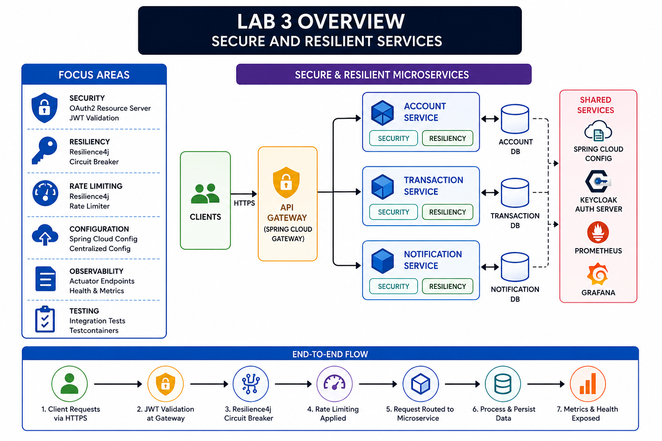
18
© 2026 by Innovation In Software Corporation
Notes:
KEY TALKING POINTS
------------------
- Focus Areas
Of the six boxes, only two and a half match Lab 3.
Security is right in spirit: each service is an OAuth2 resource server validating a JWT, signed HS256 with a lab secret from tools/issue-jwt.py.
Resiliency is right: a Resilience4j circuit breaker on AccountClient.requireActiveAccount, with the existing 2 second connect and 3 second read timeout.
Testing is partly right: unit tests for security and the breaker plus one Testcontainers integration test.
Rate limiting, Spring Cloud Config, and Prometheus-based observability are not Lab 3 tasks.
- Secure & Resilient Microservices
The centre is wrong for this lab.
There is no API gateway and no Notification Service.
Lab 3 hardens exactly two services from Labs 1 and 2: Account Service on port 8081 and Transaction Service on port 8082, each with its own PostgreSQL.
Each service validates the JWT itself.
Transaction Service relays the caller's Bearer token to Account Service with BearerTokenRelayInterceptor, which is user-delegated access.
The third capstone service, Risk Assessment, arrives on Day 5, not today.
- Shared Services
None of the four shared services are built in Lab 3.
There is no Spring Cloud Config server; configuration stays in application.yml.
There is no Keycloak; the lab guide says production would use an identity provider such as Keycloak with RSA keys, and a stand-in script issues tokens today.
Prometheus and Grafana belong to Day 4 observability.
Kafka from Lab 2 is still in play, because a successful transaction still publishes TransactionSubmitted and moves from RECEIVED to SUBMITTED.
- End-to-End Flow
The real flow for a transaction is: the caller sends POST /api/v1/transactions with an ops token; Transaction Service validates the JWT and checks the transactions.write scope, or returns 401 or 403; it calls Account Service with the relayed token through the circuit breaker; if Account Service is down or the circuit is open it returns 503 ACCOUNT_SERVICE_UNAVAILABLE with no event; if the account is ACTIVE it persists RECEIVED and publishes.
JWT is not validated at a gateway, and no rate limiting step exists.
REAL-WORLD EXAMPLES
-------------------
- Many banks start API hardening service by service, exactly as Lab 3 does, with each microservice validating tokens itself before an API gateway is introduced, so that a misconfigured gateway route can never expose an unauthenticated internal service.
- A payments hub that calls a core banking account lookup treats lookup failure as a hard stop.
Payments are rejected or queued for retry rather than approved on an assumed good account status, which is the same rule Lab 3 enforces with 503 ACCOUNT_SERVICE_UNAVAILABLE.
USE-CASE SCENARIO
-----------------
The risk platform is about to be containerised on Day 4, and the security review asks three questions: can anyone call the APIs without a token, can a teller move money, and what happens to a transaction if Account Service is down?
Lab 3 answers all three.
Without a token both APIs return 401.
A teller token has only account scopes, so POST /api/v1/transactions returns 403.
An ops token works, and its token is relayed to Account Service.
When Account Service is stopped, four failing POSTs trip the breaker, every call returns 503, no TransactionSubmitted event is published, and no log line contains the Bearer token.

Slide 21
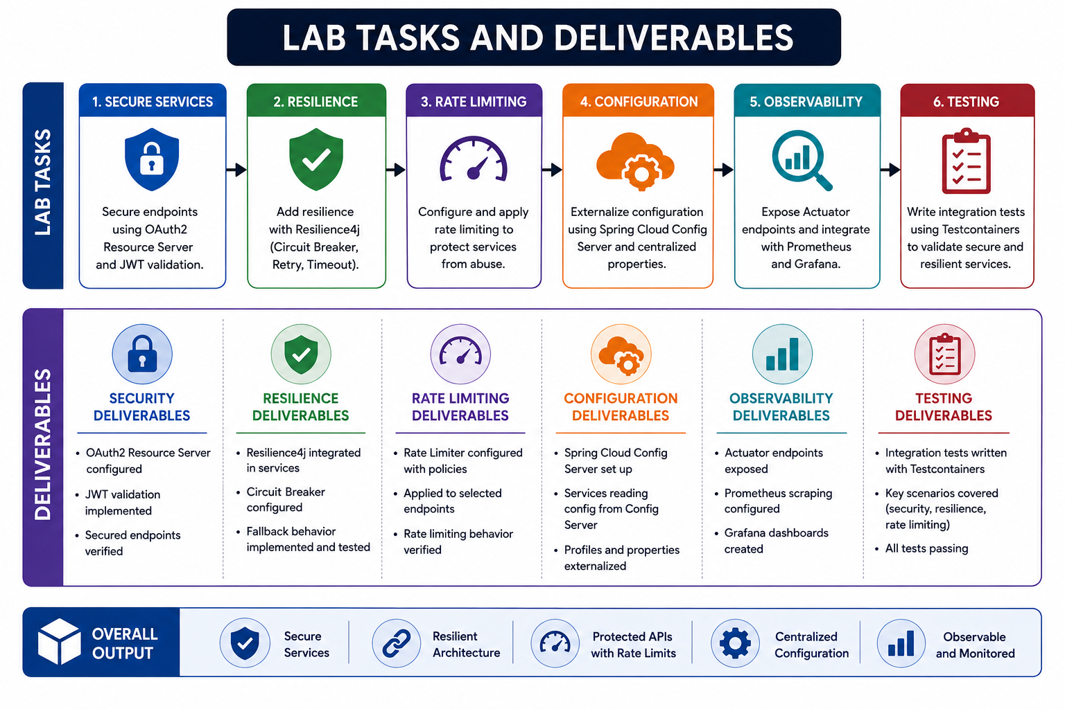
19
© 2026 by Innovation In Software Corporation
Notes:
KEY TALKING POINTS
------------------
- Lab Tasks
Map the boxes to the real guide.
Task 1 matches Steps 2 and 3: JWT resource server on Account Service then Transaction Service.
Task 2 matches Step 5, but Lab 3 adds only a circuit breaker; the timeout already exists in RestClient and there is no retry.
Tasks 3, 4 and 5, rate limiting, Spring Cloud Config and Prometheus with Grafana, are not in Lab 3.
Missing from the image: Step 1 baseline check and Step 4 Bearer token relay.
Task 6 matches Step 6, tests and log review.
- Deliverables
Keep the security column and most of the resilience column: resource server configured, JWT validation implemented, secured endpoints verified, circuit breaker configured, and fallback implemented and tested, where the fallback must throw 503 and never return a fake ACTIVE account.
Ignore the rate limiting, configuration and observability columns.
Replace the testing column: the real tests are AccountSecurityTest, TransactionSecurityTest and AccountCircuitBreakerTest, plus the guided integration test AccountPersistenceTest, with mvn test passing on both services.
Add the log checklist, which the image omits entirely.
- Overall Output
Secure Services and Resilient Architecture are the genuine outcomes of Lab 3.
Protected APIs with Rate Limits, Centralized Configuration, and Observable and Monitored are not.
The real success criteria are: no token gives 401 on both APIs; teller cannot POST transactions and gets 403; ops can POST for an ACTIVE account; the token is forwarded; Account down gives 503 with no auto-approve; the circuit opens after repeated failures; tests pass; logs stay synthetic and secret-free.
REAL-WORLD EXAMPLES
-------------------
- Bank change-approval boards commonly ask for evidence per control rather than a list of technologies: proof that unauthenticated calls are refused, that a role cannot exceed its permissions, and that downstream failure fails safe.
Lab 3's success criteria are written in exactly that evidence style.
- A payments operations team reviewing an incident found an access token printed in application logs.
Their remediation checklist mirrors Lab 3's log review: keep correlation and business ids, remove Authorization headers and token claims, and add a test so the leak cannot return.
USE-CASE SCENARIO
-----------------
At the end of Lab 3 a participant demonstrates their work to the instructor using the success checklist rather than this board.
They run curl.exe without a token and show 401 on both services.
They issue a teller token and show 403 on POST /api/v1/transactions.
With an ops token and an ACTIVE account they show 201 RECEIVED and later SUBMITTED, with the same correlation id in both service logs.
They stop Account Service, send four POSTs, and show 503 ACCOUNT_SERVICE_UNAVAILABLE and no publish.
Finally they run mvn test in both folders and grep the logs for Bearer to show nothing is found.

Slide 22
LAB 3 — SECURE AND RESILIENT SERVICES — OVERVIEW
Day 3 lab: what you build and how it grows the capstone.
🎯
WHAT YOU WILL FINISH WITH
• Both APIs reject callers without a Bearer token (401)
• Wrong scope returns 403 (not a silent 200)
• Transaction Service forwards the caller's JWT when it GETs an account
• If Account Service is down, POST /api/v1/transactions returns 503 ACCOUNT_SERVICE_UNAVAILABLE — no Kafka event, no fake ACTIVE account
• After enough failures the circuit opens; later calls fail fast
• Unit tests for security and the circuit breaker
• Logs still use synthetic ids only — no Authorization header, no token payload
KEY TAKEAWAY Lab 3 builds Secure and Resilient Services -- the working code behind today's concepts, and the next layer of the banking capstone.
20
© 2026 by Innovation In Software Corporation
Notes:
KEY TALKING POINTS
------------------
- WHAT YOU WILL FINISH WITH
Walk the list as a story of three layers.
Authentication and authorisation: no token is 401 UNAUTHENTICATED and the wrong scope is 403 ACCESS_DENIED, never a silent 200.
Delegation: Transaction Service is not a superuser; it relays the caller's Bearer token when it GETs the account.
Resilience: timeouts, 5xx errors and an open circuit all end in 503, with no transaction persisted and no TransactionSubmitted event.
After four failed calls the breaker opens and fails fast.
Evidence: tests plus logs with accountId and correlationId but never an Authorization header or token claims.
REAL-WORLD EXAMPLES
-------------------
- In card authorisation, if the service that checks card or account status cannot be reached, the safe design is to decline or return a retryable error, not to approve by default.
The 503 with no fake ACTIVE account in Lab 3 applies the same fail-closed principle to transaction submission.
- Security reviews at financial institutions commonly scan application logs for bearer tokens, session IDs and personal data, because logs are copied widely and kept a long time.
That is why the last outcome insists logs carry only synthetic IDs.
USE-CASE SCENARIO
-----------------
Tell the story of a Tuesday incident.
Account Service's database fails over and Account Service is unreachable for about two minutes.
Without Lab 3, Transaction Service requests hang until the timeout, threads pile up, and a well-meaning fallback that assumes ACTIVE lets transfers through against an account frozen that morning for suspected fraud.
With Lab 3, the first four calls fail within the 3-second read timeout, the circuit opens, later calls get an instant 503 ACCOUNT_SERVICE_UNAVAILABLE, and nothing is persisted or published.
Logs show accountId and correlationId for the investigation but no tokens.
About 10 seconds after Account Service recovers, the breaker tries again and traffic resumes.

Slide 23
LAB 3 — SECURE AND RESILIENT SERVICES — BEFORE YOU START
Check these before the lab clock starts.
📚 KNOWLEDGE YOU NEED (FROM DAY 3)
Day 3 idea | How it appears in this lab
Resource server | Each API validates a JWT. It does not log users in with a form.
Scopes | accounts.read / accounts.write and transactions.read / transactions.write.
Workload vs user | The human caller holds the JWT. Transaction Service relays that token to Account Service.
Timeout | RestClient already uses a 2s connect / 3s read timeout. That is the timeout.
Circuit breaker | Resilience4j wraps AccountClient.requireActiveAccount. Repeated failures open the circuit.
Safe fallback | Fallback throws 503. It must not return a synthetic ACTIVE account.
Log redaction | Log accountId and status. Never log Bearer tokens or JWT claims.
KEY TAKEAWAY Settle prerequisites and environment first -- most lab time is lost to setup, not to code.
21
© 2026 by Innovation In Software Corporation
Notes:
KEY TALKING POINTS
------------------
- KNOWLEDGE YOU NEED (FROM DAY 3)
Go row by row.
Resource server: each API validates an HS256 JWT signed with the classroom secret and checks issuer md287-lab; there is no login form.
Scopes: accounts.read and accounts.write, transactions.read and transactions.write, which Spring exposes as SCOPE_ authorities.
Workload versus user: the human's token is relayed, not a service account's.
Timeout: already set, 2 s connect and 3 s read, so do not add another.
Breaker: Resilience4j on requireActiveAccount.
Fallback: throw 503, never return ACTIVE.
Redaction: log accountId and status only.
REAL-WORLD EXAMPLES
-------------------
- A bank's branch teller application may let staff open or freeze accounts but not initiate outbound payments, while an operations role can submit transactions.
Separating accounts.write from transactions.write mirrors that segregation of duties.
- When a mobile banking app calls a transfer API that in turn calls an account API, many designs pass the customer's delegated token downstream so each API enforces the customer's own permissions.
That is the user-delegated relay this lab builds, as opposed to a privileged service account.
USE-CASE SCENARIO
-----------------
A participant says the timeout seems missing and plans to add a Resilience4j TimeLimiter on AccountClient.
Stop and point to the Timeout row: RestClient already uses a 2-second connect and 3-second read timeout, and that is the timeout for this lab.
Adding a second layer can create confusing interactions and burns lab time.
Another participant plans to give Transaction Service its own admin token for Account calls.
Point to the Workload vs user row.
This lab relays the human caller's token so Account Service enforces that user's accounts.read scope.
Client credentials is an optional stretch sketch, not something to build.

Slide 24
LAB 3 — SECURE AND RESILIENT SERVICES — LAB STEPS
6 steps, worked in order.
1️⃣
LAB STEPS
2️⃣
LAB STEPS (CONTINUED)
• Step 1 — Start both services and prove they are still open
• Step 2 — Protect Account Service with JWT
• Step 3 — Protect Transaction Service the same way
• Step 4 — Relay the Bearer token to Account Service
• Step 5 — Circuit breaker and safe fallback
• Step 6 — Tests and log review
KEY TAKEAWAY Work the steps in order -- each one builds on the last.
22
© 2026 by Innovation In Software Corporation
Notes:
KEY TALKING POINTS
------------------
- LAB STEPS
Step 1: docker compose up and mvn spring-boot:run in each starter, then health on 8081 and 8082 without a token.
Creating an account still returns 201, which proves the baseline, so a later 401 means JWT works and not that Postgres is down.
Step 2: in account-service SecurityConfig, add an HS256 JwtDecoder, permit health, info and swagger, require SCOPE_accounts.read for GET and SCOPE_accounts.write for writes, and restart.
Expect 401 without a token and 201 with the teller token.
Step 3: same secret and issuer in Transaction Service; POST needs transactions.write.
- LAB STEPS (CONTINUED)
Step 4: register BearerTokenRelayInterceptor in RestClientConfig.
Activate an account with the teller token, then POST as ops with X-Correlation-Id lab3-demo.
Expect 201 RECEIVED, later SUBMITTED, and no Bearer text in either log.
Step 5: add @CircuitBreaker on requireActiveAccount with fallbacks that rethrow AccountNotEligibleException and wrap everything else as unavailable.
Stop Account Service and POST four times for a 503.
Restart it and retry after about 10 seconds.
Step 6: run mvn test in both services and work the log checklist.
REAL-WORLD EXAMPLES
-------------------
- Enterprise teams rolling out token validation across existing services usually secure one service, verify it, then move to the next, rather than switching everything at once.
Doing it that way means a failure can be traced to a single change, which is why Steps 2 and 3 are separate.
- Chaos or failure testing in financial services often starts as simply as this lab's Step 5: stop one dependency in a controlled environment and confirm that callers fail fast and that no transaction is recorded or approved.
USE-CASE SCENARIO
-----------------
Halfway through, a participant finishes Step 3 and posts a transaction with the ops token.
The response is 503 ACCOUNT_SERVICE_UNAVAILABLE, even though Account Service is up.
They suspect the breaker, but they have not reached Step 5.
Walk them through it.
Account Service's log shows a 401 on the account GET, because Transaction Service is not yet relaying the token.
The client turns a downstream 401 or 403 into an unavailable error, so the caller sees 503.
The fix is Step 4, one line in RestClientConfig.
The lesson is that a fail-closed fallback can mask a configuration mistake, so check the downstream log before blaming the network.

Slide 25
LAB 3 — SECURE AND RESILIENT SERVICES — SUCCESS CRITERIA
You are done when every box below is ticked.
✅
SUCCESS CRITERIA
✅
SUCCESS CRITERIA (CONTINUED)
• No token → 401 on both business APIs
• Teller cannot POST transactions (403)
• Ops can POST a transaction for an ACTIVE account
• Token is forwarded; Account GET is authorized
• Account down → 503, no auto-approve
• Circuit opens after repeated failures
• mvn test passes on both services (includes the guided integration test AccountPersistenceTest)
• Logs stay synthetic and secret-free
KEY TAKEAWAY Tick every criterion before moving on -- the next lab builds directly on this one.
23
© 2026 by Innovation In Software Corporation
Notes:
KEY TALKING POINTS
------------------
- SUCCESS CRITERIA
Each tick needs a command and an observed result.
No token: curl.exe without Authorization to 8081 and 8082 returns 401 with code UNAUTHENTICATED, while health still returns 200.
Teller: POST to /api/v1/transactions returns 403 ACCESS_DENIED.
Ops: with an ACTIVE account in requests/create-valid.json, POST returns 201 RECEIVED and a later GET shows SUBMITTED.
Forwarding: Account Service's log shows the GET with the same correlationId, and Account returned 200 rather than 401.
- SUCCESS CRITERIA (CONTINUED)
Account down: stop Account Service and POST as ops.
Expect 503 ACCOUNT_SERVICE_UNAVAILABLE, no new transaction, no TransactionSubmitted publish, and nothing logged as ACTIVE.
Circuit: after four failed calls, logs show the circuit-open fallback and responses come back immediately.
Tests: mvn test in each folder, where AccountSecurityTest, TransactionSecurityTest and AccountCircuitBreakerTest must pass and AccountPersistenceTest needs Docker running.
Logs: accountId, transactionId and correlationId present; no Authorization header, no scope or sub dumps.
REAL-WORLD EXAMPLES
-------------------
- Before a release, banks commonly require evidence rather than assertions: a test report, a captured response, a log sample.
Treating each criterion here as a screenshot or command output builds the same habit an audit or change review will expect.
- Log hygiene checks are common in regulated environments.
Teams search log output for patterns such as Bearer or eyJ, the usual start of an encoded JWT, to confirm no credentials leaked.
Participants can run the same search on their console output.
USE-CASE SCENARIO
-----------------
Run a two-minute peer sign-off.
Each participant swaps seats, or screens, with a neighbour, who acts as the release approver and asks for evidence on three criteria chosen at random.
A typical exchange: show me Account down gives 503.
The owner stops Account Service, posts as ops, and the approver checks the status, the error code, and that GET transactions shows no new row.
Then: show me logs are secret-free.
The owner searches the console for Bearer and finds nothing.
Anyone who cannot produce evidence on the spot goes back to that step.
This mirrors how a real change approval works on the Transaction Risk Platform.

